Slide 1

Poverty, inequality & the cost of living crisis
Dr Lisa Wilson
28th September 2022
Twitter: @lisawilson_NERI
Website: www.nerinstitute.net

Slide 2
Overview
What is poverty and inequality? Concept
How do we capture? Measurement & data.
How poor are we?
How unequal are we?

Slide 3
What is poverty?
Definitions really matter.
They set the standards by which we determine whether the incomes and living conditions of the poorest in society are acceptable or not.
Underappreciated that it is from these definitions that all actions to help the poorest follow.

Slide 4
What is poverty?
Absolute poverty
Relative poverty – broad acceptance of Townsend approach.
“poverty is defined as those people whose resources are so seriously below those commanded by the average individual or family that they are, in effect, excluded from ordinary living patterns, customs and activities.”
Recent refocus of poverty to be focused on particular issues: ‘food poverty’ or ‘fuel poverty’

Slide 5
How do we measure poverty?
Direct
Indirect
Income threshold approaches: absolute & relative.
Deprivation & consensual standards.
Minimum budget standards.
Combined income & deprivation definitions.
Persistent poverty.

Slide 6
Official measurement of poverty
Focus on income threshold approaches.
Relative poverty - An individual is considered to be in relative poverty if they are living in a household with an equivalised income below 60% of UK median income in the year in question.
Absolute poverty - An individual is considered to be in absolute poverty if they are living in a household with an equivalised income below 60% of the (inflation adjusted) UK median income in 2010/11.
Both are estimated on both a before and after housing costs basis.
Northern Ireland - NISRA, Northern Ireland Statistics Research Agency is official source for poverty statistics in NI – based on data collected in Family Resources Survey & published annually in Households Below Average Incomes report. Modified OECD equivalence scale, but rescaled so that reference household = couple.
Some think it’s noteworthy that NI relative poverty rate is based on 60% of UK median income. Should we use Donegal median household income to work out poverty rate in Donegal?

Slide 7
Other measures of poverty
No population estimates of deprivation produced.
Children in combined low income & material deprivation – Published by NISRA.
Pensioners in material deprivation – Published by NISRA.
Family Resources survey – Has 21 items in the suite of questions used to measure material deprivation which are designed to reflect the items and activities people in the UK believe to be necessary. These items are reviewed periodically to ensure the measure remains a relative measure of poverty. Only 8 of these are asked of adults.
Last periodic review 2010. McKay, Review of the child& pensioner material deprivation items in the family resources survey.

Slide 8
Population: Before housing costs

Slide 9
Working age adults: Before housing costs

Slide 10
Child poverty: Before housing costs

Slide 11
Poverty: After housing costs
Note: For ROI any person with an equivalised income after rent and mortgage interest of less than 60% of the median AFTER rent and mortgage interest is considered at risk of poverty after rent and mortgage (Variable: eq_inc_ex_rent_mort_int (2020 onwards only).
For NI housing costs include the following: • Rent (including housing benefit); • Mortgage interest payments; • Structural insurance premiums (for owner occupiers); and • Ground rent and service charges.
Notes:
20% of children equates to about 240000 children.

Slide 12
Income in the UK

Slide 13
Income by quintile UK, 1977-2021

Slide 14
Quintile group medians Northern Ireland
Source: HBAI NI, August 2021

Slide 15
What is income inequality?
Income inequality is the extent to which income is distributed unevenly in a group of people.
Income is not just the money received through pay, but all the money received from employment (wages, salaries, bonuses etc.), investments, such as interest on savings accounts and dividends from shares of stock, savings, state benefits, pensions (state, personal, company) and rent.
Income inequality is measured as household disposable income in a particular year. It consists of earnings, self-employment and capital income and public cash transfers; income taxes and social security contributions paid by households are deducted.
The income of the household is attributed to each of its members, with an adjustment using an ‘equivalence scale’ to reflect differences in composition & needs for households of different sizes.

Slide 16
How do we measure income inequality?
The Gini coefficient is based on the comparison of cumulative proportions of the population against cumulative proportions of income they receive, and it ranges between 0 in the case of perfect equality and 1 in the case of perfect inequality.
S80/S20 is the ratio of the average income of the 20% richest to the 20% poorest; P90/P10 is the ratio of the upper bound value of the ninth decile (i.e. the 10% of people with highest income) to that of the first decile.
P90/P50 of the upper bound value of the ninth decile to the median income.
P50/P10 of median income to the upper bound value of the first decile.
The Palma ratio is the share of all income received by the 10% people with highest disposable income divided by the share of all income received by the 40% people with the lowest disposable income.

Slide 17
Income inequality, NI & UK

Slide 18
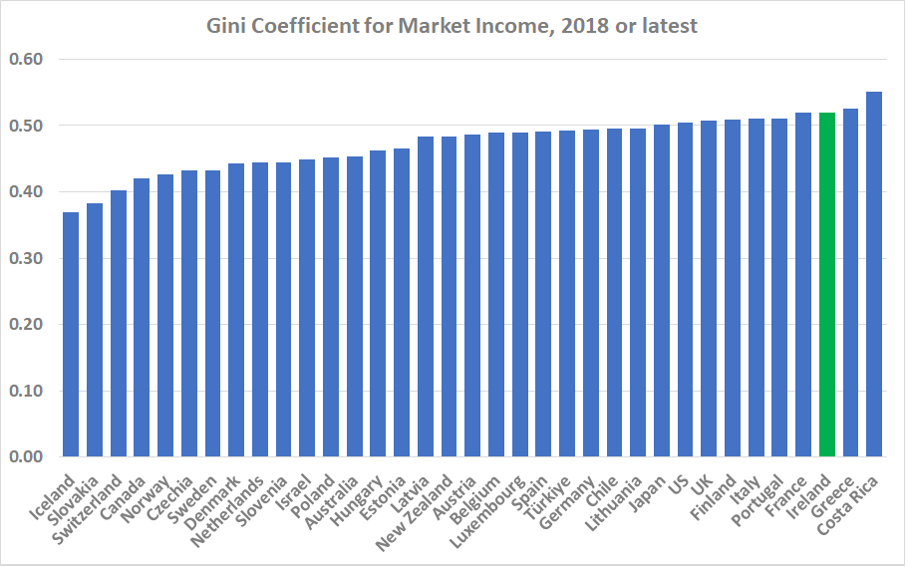

Slide 19
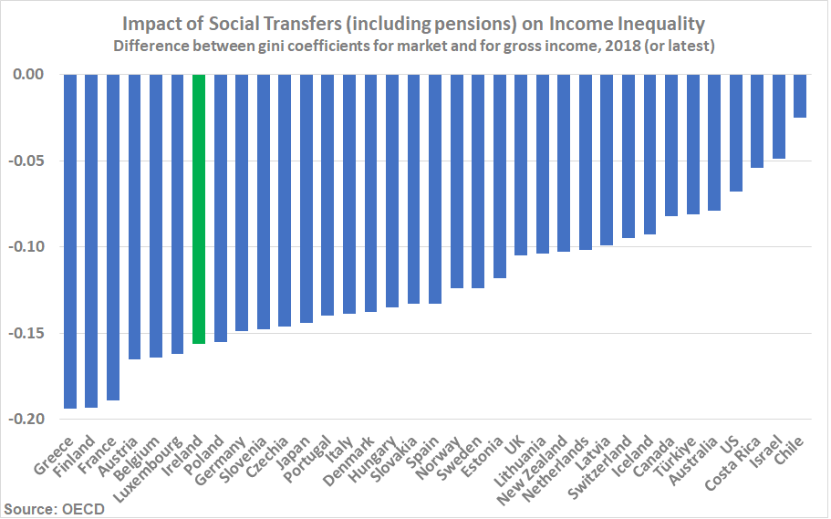

Slide 20
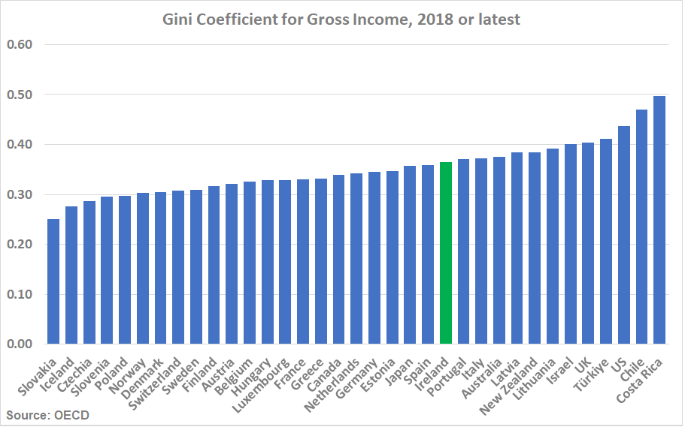

Slide 21
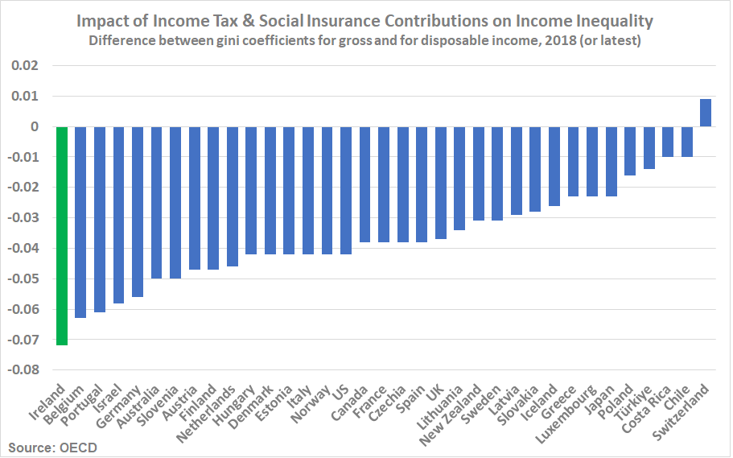

Slide 22
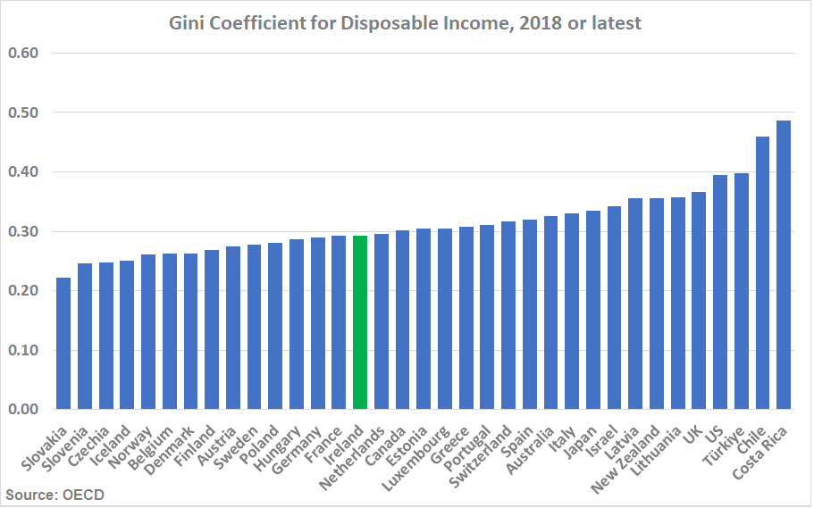

Slide 23
Poverty, inequality & the cost of living crisis
Dr Lisa Wilson
28th September 2022
Twitter: @lisawilson_NERI
Website: www.nerinstitute.net

