Slide 1

Private Sector Wages:
Some Trends, Prospects and Issues
20th November 2018
(Not for circulation or citation)
Dr Tom McDonnell
Senior Economist
NERI (Nevin Economic Research Institute)
Dublin
email-address@NERInstitute.net
www.NERInstitute.net

Slide 2
Wages Trends
Recent Performance

Slide 3
Real compensation per employee (annual % change) based on private consumption deflator (EU Commission), *forecast
 | 2010 | 2011 | 2012 | 2013 | 2014 | 2015 | 2016 | 2017 | 2018* | 2019*
Ireland | -1.0 | -0.1 | -1.2 | -1.5 | 0.6 | 1.7 | 1.2 | 1.7 | 1.2 | 1.4
Euro area | 0.6 | -0.2 | 0.0 | 0.5 | 0.9 | 1.1 | 0.8 | 0.2 | 0.9 | 0.4
UK | 1.4 | -2.6 | -0.4 | 0.4 | -1.3 | 0.4 | 1.9 | 0.9 | 0.9 | 1.4
2010 real compensation = 100
2016 comp (Ireland) = 103.6
2018 comp (Euro area) = 104.2
2016 comp (UK) = 101.5
Ireland
Commission forecast for nominal compensation per employee:
2018 = 2.5%
2018 = 2.6%

Slide 4
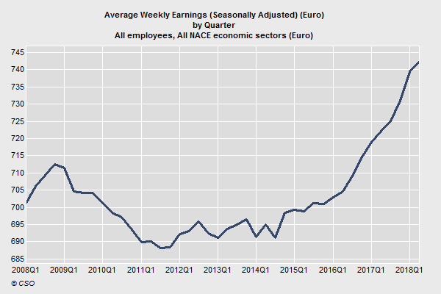
Average Weekly Earnings, Euros
(All employees, Seasonally Adjusted) – EHECS
Annual change in seasonally adjusted earnings Q2’17 to Q2’18 = 2.8%
Ten year change (Q2’08 to Q2’18) = 5.1% (0.5% per annum)
Real weekly earnings grew by an average of 2% between 1938 and 2015

Slide 5
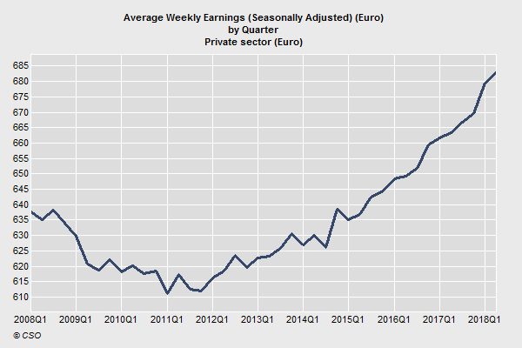
Average Weekly Earnings, Euros
(Private sector employees, Seasonally Adjusted) – EHECS
€682.81 in Q2 2018 (seven years of stagnation but 7.2% growth since Q2 2015)
Increases were badly distributed in the recovery period with managers/professionals receiving the fastest increases – production and craft workers took a loss between Q1’13 and Q1’18
Annual change in seasonally adjusted earnings Q2’17 to Q2’18 = 2.9%
Ten year change (Q2’08 to Q2’18) = 7.5% (0.7% per annum)

Slide 6
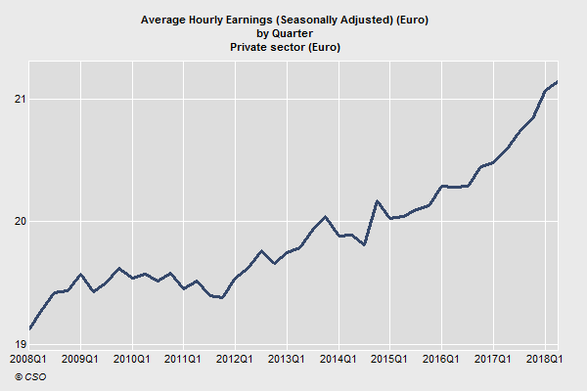
Average Hourly Earnings, Euros
(Private sector employees, Seasonally Adjusted) – CSO EHECS
€21.14 in Q2 2018
Annual change in seasonally adjusted earnings Q2’17 to Q2’18 = 2.7%
Ten year change (Q2’08 to Q2’18) = 9.6% (0.9% per annum)

Slide 7
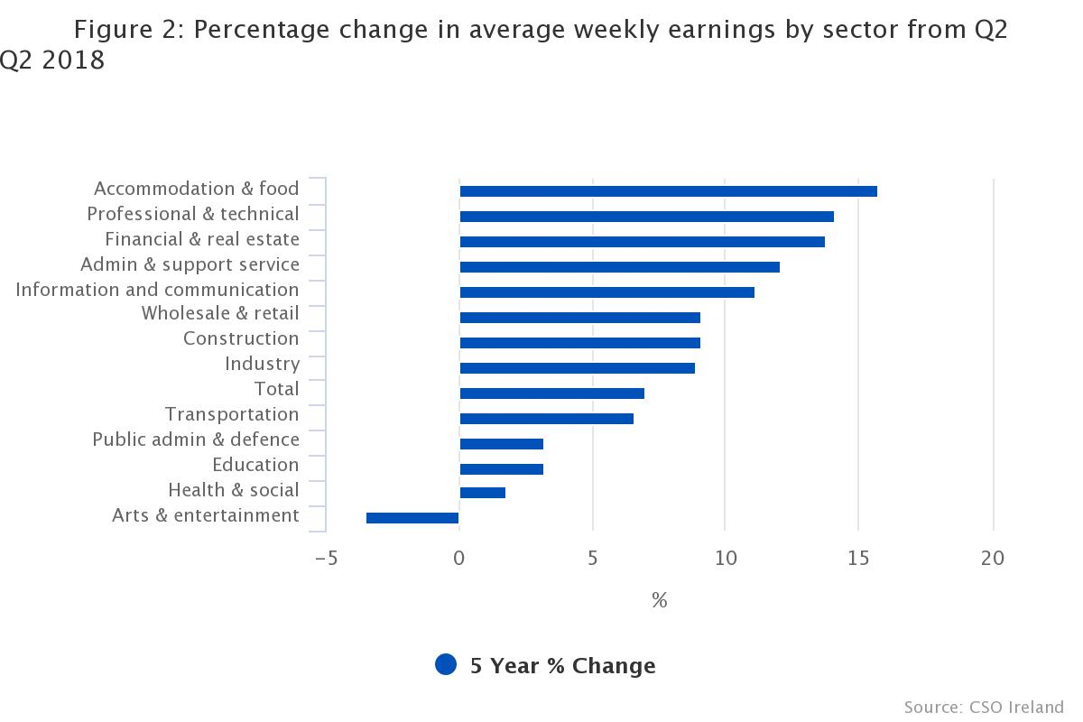
Sectoral wage trends – Q2 2013 to Q2 2018
Different time frames present different pictures.
e.g. the gains for hospitality wages over the 5 year period must be considered along with the losses in the recession. Over the 10 year period hospitality wages have lagged overall wage increases.

Slide 8
Average Hourly Regular Earnings (Euro) by
Type of Employment, (Seasonally adjusted), % increase by period
Average Hourly Earnings (Seasonally Adjusted) (Euro)
 |  | 2015Q2 | 2016Q2 | 2017Q2 | 2018Q2 | 15 to 18 % | 17 to 18 %
All employees
 | All NACE economic sectors | 21.87 | 21.96 | 22.36 | 22.9 | 4.7 | 2.4
 | Mining and quarrying (B) | 24.54 | 24.57 | 23.56 | 24.67 | 0.5 | 4.7
 | Manufacturing (C) | 21.6 | 21.94 | 21.98 | 22.69 | 5 | 3.2
 | Construction (F) | 19.32 | 19.9 | 19.88 | 20.73 | 7.3 | 4.3
 | Wholesale and retail trade; repair of motor vehicles (G) | 17.35 | 17.66 | 18.15 | 18.41 | 6.1 | 1.4
 | Transportation and storage (H) | 20.25 | 20.95 | 21.05 | 21.65 | 6.9 | 2.9
 | Accommodation and food service activities (I) | 12.17 | 12.44 | 12.68 | 12.95 | 6.4 | 2.1
 | Information and communication (J) | 29.59 | 29.58 | 29.97 | 31.6 | 6.8 | 5.4
 | Financial and insurance activities (K) | 30.43 | 30.37 | 31.41 | 32.97 | 8.3 | 5
 | Real estate activities (L) | 23.11 | 23.38 | 23.64 | 24.6 | 6.4 | 4.1
 | Professional, scientific and technical activities (M) | 24.78 | 25.51 | 25.94 | 27.31 | 10.2 | 5.3
 | Administrative and support service activities (N) | 17.4 | 17.13 | 17.56 | 17.98 | 3.3 | 2.4
 | Public administration and defence (O) | 25.38 | 25.02 | 25.85 | 25.99 | 2.4 | 0.5
 | Education (P) | 34.21 | 33.86 | 34.38 | 35.58 | 4 | 3.5
 | Human health and social work activities (Q) | 21.98 | 21.98 | 22.51 | 22.6 | 2.8 | 0.4
 | Electricity, water supply and waste management (D,E) | 27.51 | 28.35 | 27.94 | 28.06 | 2 | 0.4
 | Arts, entertainment, recreation and other (R,S) | 17.31 | 16.51 | 16.58 | 17.11 | -1.2 | 3.2

Slide 9
Labour cost index (hourly basis) – Eurostat
(Business economy)
Labour Cost Index 2012 = 100
  Ireland (2017) = 106.4 (19th out of 28 EU countries over the period) ;
  EU (2017) = 109.2; UK (2017) = 111.9
Wages and Salaries Index 2012 = 100
  Ireland (2017) = 106.4 (20th out of 28 EU countries over the period)
  EU (2017) = 109.9; UK (2017) = 111.4 (Only Greece and Spain are sub 100)
If we go back further we find Irish wages lagging well behind the Euro area.
Recent year-on-year changes in LCI (Q/Q-4):
 | 2016 Q2 | 2017 Q2 | 2018 Q2
Ireland | 1.4 | 1.9 | 2.9
Euro area 19 | 0.7 | 2.2 | 2.4
UK | 2.7 | 2.4 | 2.8

Slide 10
Labour Costs (Euro per hour worked)
Business economy in high income EU countries (at least 1 million population and GDP at least €30,000 per capita)
Ireland 31.0
  Only the UK is lower amongst high-income ‘peer’ countries and all bar UK and Finland are at least 10% higher. Denmark is over 37% higher.
Denmark = 42.5
Belgium = 39.5
Sweden = 38.3
France = 36.0
Germany = 34.8
Austria = 34.1
Netherlands = 34.1
Finland = 32.1
Ireland (Republic) = 31.0
UK = 25.7

Slide 11
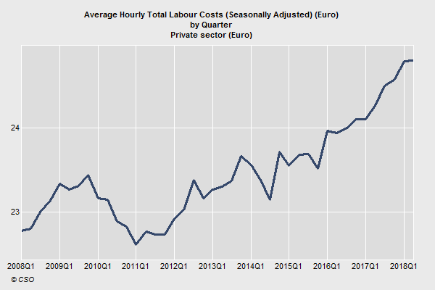
Seasonally adjusted hourly labour costs in the private sector:
8.7% growth in 10 years
Private sector:
to
Q2’18 = +2.2%
Q2’17 = +1.3%
Q2’16 = +1.1%
2018 Q2 = 24.79; 2017 Q2 = 24.26; 2008 = 22.81

Slide 12
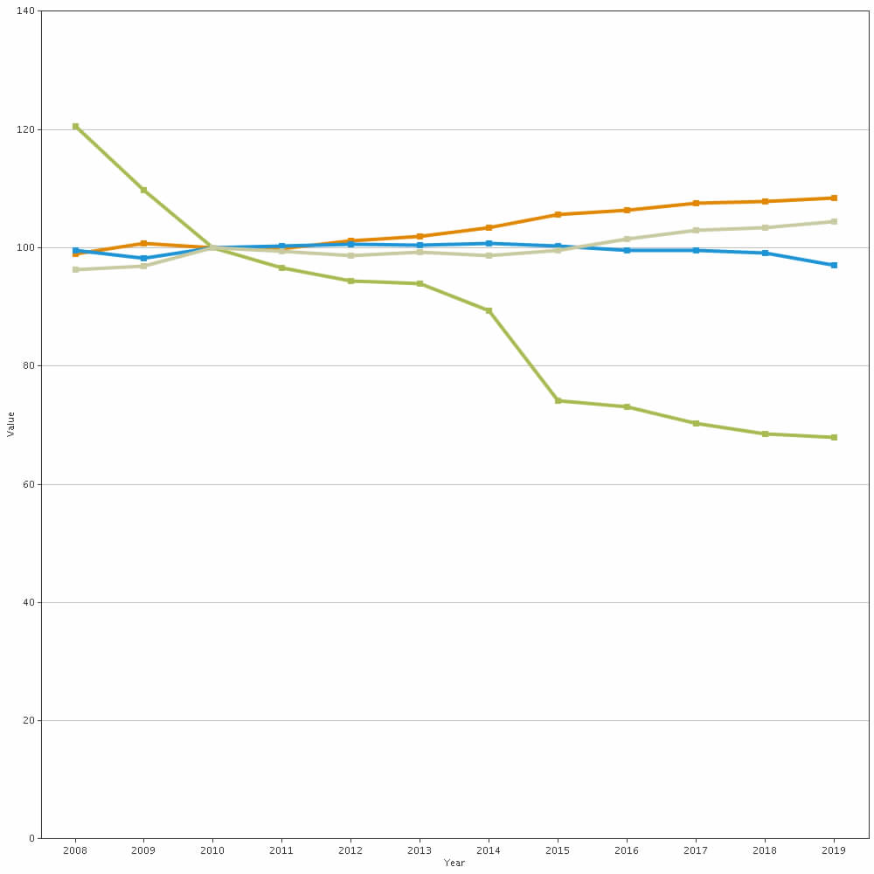
Nominal unit labour costs: total economy: -
Performance relative to the rest of the EU15: double export weights (AMECO)
Note the competitive ‘performance’ improves prior to the leap in GDP in 2015
Ratio of compensation per employee to real GDP per person employed (Index: 2010 = 100)
Ireland = green; UK = grey; Germany = orange; Greece = blue
Green is Ireland; Orange is Germany; UK is Grey; France is blue

Slide 13
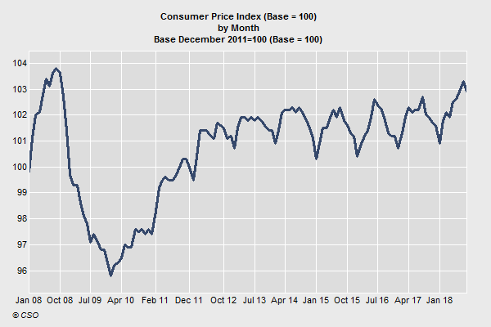
The CPI fell by 0.9% between Sep 2008 and Sep 2018 but is up 6% between Sep 2009 and Sep 2018
The CPI is up by 1.1% between Sep 2013 and Sep 2018 and by 0.9% between Sep 2017 and Sep 2018

Slide 14
Prospects for Wages
Future Trends

Slide 15

Projecting wage rates – the base equation
Wage Determination
Log(WAGE) = a₁ + a₂log(OUTPUTPR) + a₃log(CONSPR) + a₄log(TAX) + a₅log(LABPROD) + a₆UNEMP + a₇log(OTHER)
WAGE represents the wage rate; OUTPUTPR is the price of internationally traded goods (output); CONSPR is the consumption price deflator; TAX is the tax 'wedge'; LABPROD is labour productivity; UNEMP is the rate of unemployment (this is really a proxy for the tightness of the labour market – could also use sectoral/regional Job Vacancy Rates); Crucially, to what extent is the economy overheating? OTHER is everything else and includes things like trade union density
Wage rates are assumed to be determined as the outcome of a bargaining process - explanatory variables: output prices (+); consumer prices (+); tax wedge (+); unemployment rate (-); labour productivity (+); 0ther (+ and -)

Slide 16
Is the economy overheating?
Cannot directly observe the cyclical position of the economy.
Most of the relevant indicators suggest that the economy is not, as of yet, overheating.
Consumer price inflation has been below 1 per cent since 2012 and grew just 0.9 per cent year-on-year in September.
The housing savings rate was 9.7 per cent of gross disposable income in the first quarter of 2018, a figure that is above the long-run average of 8.4 per cent.
Housing completions are well below the long-run average and below the rate of new household formation.

Slide 17
Is the economy overheating? (cont.)
Labour market performance, while improving in recent years, is unremarkable by EU standards, with unemployment and employment rates significantly worse than the best EU performers.
Ireland’s unemployment rate is higher than in 14 other EU countries and higher than the OECD average. The job vacancy rate, a measure of labour market tightness, is one of the weakest in the entire EU at 1.1, compared to 2.2 in the EU as a whole, and 5.4 in the Czech Republic. Taken as a whole, the evidence suggests there is some additional slack remaining in the labour market.
Many of the traditional indicators (e.g. GDP) are of limited use given the distortion to the national accounts. For example, there was a current account surplus of 12.8 per cent in the first half of 2018, but this surplus includes a significant amount of contract manufacturing activity that actually happens outside Ireland.

Slide 18
Is the economy overheating? (cont.)
On the other hand, underlying investment in the economy (i.e. stripping out IP assets and aircraft) has been growing by double digits year-on-year in each of the last three quarters, while personal consumption and retail sales are both growing relatively quickly.
There is also significant asset price inflation with residential property prices experiencing double-digit growth, although property prices are still only four fifths of peak levels.
In addition, average weekly and hourly wages are up 3.3 per cent and 2.8 per cent respectively year-on-year in the second quarter. As such, real wage growth is currently over 2 per cent, and this is suggestive of a tightening labour market.
However, these recent gains should be viewed in the context of an almost decade long stagnation in wage growth. Similarly, the fast growth in personal consumption in the first half of 2018 follows relatively subdued growth of 1.6 per cent in 2017.

Slide 19
Sectoral Job Trends (SA)
SA Employment in Q2 2018 is 35,600 up on Q2 2008 and 74,700 up on Q2 2017
Just 9 out of 14 sectors have reached or exceeded 2008 employment levels
Construction (67.1%), Wholesale/Retail (90.6%) and Industry (90.5%) are among the sectors furthest from recovery
ICT (130.7%), Accom/food (117.6%) and Health (116.6%) are the best performers
Both sexes | 2008Q2 | 2017Q2 | 2018Q2 | Ratio 18/08 (%) | Ratio 18/17 (%)
Agri, forestry, fishing | 116.1 | 109.2 | 105.0 | 90.4 | 96.2
Industry | 307.6 | 282.4 | 278.3 | 90.5 | 98.5
Construction | 215.1 | 127.0 | 144.4 | 67.1 | 113.7
Wholesale/retail | 331.4 | 302.6 | 300.1 | 90.6 | 99.2
Transport & storage | 91.5 | 92.5 | 97.0 | 106.0 | 104.9
Accommodation/food | 136.3 | 160.1 | 177.5 | 130.2 | 110.9
ICT | 86.8 | 115.3 | 116.4 | 134.1 | 101.0
Financial, insurance and real estate | 110.9 | 106.3 | 109.8 | 99.0 | 103.3
Professional etc. | 129.4 | 135.3 | 141.2 | 109.1 | 104.4
Administrative | 97.4 | 93.3 | 102.5 | 105.2 | 109.9
Public admin | 94.6 | 98.3 | 103.8 | 109.7 | 105.6
Education | 142.2 | 157.1 | 166.9 | 117.4 | 106.2
Health &social work | 241.1 | 279.8 | 286.1 | 118.7 | 102.3
Other | 110.0 | 116.9 | 116.5 | 105.9 | 99.7
All economic sectors | 2220.9 | 2181.8 | 2256.5 | 101.6 | 103.4

Slide 20
Total employment rates – 20 to 64 years (% of pop) a long way behind best performers (we are at median)
2017
Ireland = 73.0% (joint 15th) – peaked at 75.1% in 2007 before falling to 64.5% in 2012
EU = 72.2%
Highest in EU is Sweden at 81.8% (Iceland is 87.6%) and lowest in EU is Greece at 57.8%

Slide 21
Unemployment rates –Ireland is a mediocre performer (14th best in the EU)
Unemployment rate seasonally adjusted – September 2018
Ireland is 5.4% - joint 14th best in the EU (EU median is 5.4%)
Range is Czechia (2.3%) to Greece (19.0%)
Major countries:
  Germany 3.4%
  Poland 3.4%
  USA 3.7%
  UK 4.0%
  France 9.3%
  Italy 10.1%
  Spain 14.9%
Is there such a thing as a ‘normal’ unemployment rate?
Still room for further strengthening in the labour market – labour market is not yet ‘tight’, though sectoral specific tightness (e.g. in ICT) may exist

Slide 22
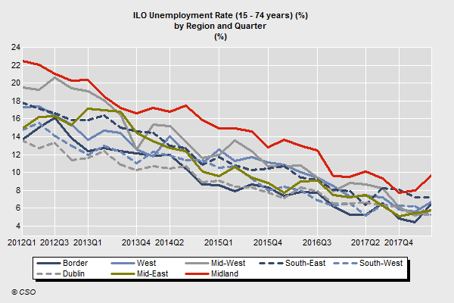
Unemployment is trending downwards in all regions
State = 6.0% in Q2 (regional variation = 5.3% to 9.7%)
Midlands is the poorest performer

Slide 23
Ireland has a relatively low job vacancy rate…..suggests a soft labour market
EU job vacancy rate (JVR) of 2.0% in Q2 2017 and 2.2% in Q2 2017
Czechia has the highest JVR at 5.4% while Greece is lowest at 0.7%
 | 2017 Q2 | 2018 Q1 | 2018 Q2
EU 28 | 2.0 | 2.2 | 2.2
Ireland | 1.1 | 1.0 | 1.1
Germany | 2.7 | 2.9 | 2.9
United Kingdom | 2.6 | 2.5 | 2.7
Spain | 0.8 | 0.9 | 0.9
Rate = Job vacancies/(occupied posts + no. of job vacancies)*100
Ireland is just 20th out of 24 EU countries

Slide 24
Job Vacancy Rates by Sector – slow improvement
JVR suggests labour market is particular soft in construction (0.3%) and retail (0.6%)
Even so, I anticipate these demand–led sectors will experience employment growth
Disparity between sectors

Slide 25
Irishjobs.ie suggests vacancy-employment rates are highest in the East and low in the Midlands
IrishJobs: Every county bar 3 (Clare, Kerry, Donegal) recorded a year-on-year increase in job vacancies in Q3 2018
  Dublin +19%; Cork +5%; Limerick +2%
Largest share of job vacancies is in hotel/catering
Job Vacancy Rates (JVRs) highest in Dublin, Carlow and Limerick
JVRs lowest in Kerry, Cavan, Donegal and Midlands counties
4% annual increase in Job Vacancies in Q3’18 with a 15% increase in Accountancy/finance and 8% in construction/property

Slide 26
Job vacancy and labour market context…..
Scenario 1: High vacancy and low unemployment
Suggestive of a tight labour market – most consistent with wage inflation
Scenario 2: Low vacancy and low unemployment
Consistent with baseline wage growth
Scenario 3: High vacancy and high unemployment
Suggestive of a mismatch between the education/skills profile of the labour force and employer requirements – differentiated wage growth
Scenario 4: Low vacancy and high unemployment
Associated with recessions or structurally poor performance – and weak wage growth
……………………………………………………………………………………
We moved from Scenario 1 (circa 2003-2008) to Scenario 4 (circa 2009-2015)
Scenario 2 most accurately describes the current situation – this has important implications for wage growth.
A return to Scenario 1 is feasible and would arise if the economy was overheating for an extended period

Slide 27
Dept. Finance Labour Market
Expectations, % growth (Budget - Oct, 2018)
% change | 2017 | 2018 | 2019 | 2020 | 2021 | 2022
Real GDP | 7.2 | 7.5 | 4.2 | 3.6 | 2.5 | 2.6
Real GNP | 4.4 | 5.9 | 3.9 | 3.3 | 2.3 | 2.4
Employment | 2.9 | 3.0 | 2.8 | 2.2 | 1.5 | 1.6
Unemployment (rate) | 6.7 | 5.8 | 5.2 | 5.0 | 5.0 | 5.0
Compensation of employees | 5.4 | 5.6 | 5.6 | 5.4 | 5.2 | 5.0
Compensation per Employee | 2.2 | 2.8 | 3.1 | 3.2 | 3.4 | 3.4
Labour productivity (per person employed) | 4.2 | 4.4 | 1.4 | 1.3 | 1.0 | 0.9
Inflation – HICP | 0.3 | 0.7 | 1.5 | 1.7 | 2.9 | 2.4
Personal consumption deflator | 1.4 | 1.5 | 2.0 | 2.1 | 2.9 | 2.4

Slide 28
Institutional Forecasts for 2019
Employee Compensation and Inflation
Compensation per Employee
  Dept. Finance: 3.0%
  ESRI: 2.9% (Average Hourly Earnings)
  Central Bank: 3.3%
  NERI: 3.4% (Average Hourly Earnings)
Harmonised Index of Consumer Prices
  Dept. Finance: 1.5%
  ESRI: 1.1%
  Central Bank: 0.8%
  IMF: 1.2%
  EU Commission: 1.3%
  OECD: 2.1%
General consensus that unemployment will fall in the short-term
  Dept. Finance: 5.2%
  Central Bank 4.7%
  ESRI 5.1%
  NERI 5.2%

Slide 29
Establishing a Baseline
Considerations

Slide 30
A Baseline?
(All things equal)
Nominal compensation must rise in line with inflation just to hold steady in terms of real compensation – consumer inflation is likely to average circa 1.99% over the medium-term (the ECB target) – Ireland’s higher than average growth potential might influence upwards implying inflation in the 2-2.5% range over the medium-term
Labour productivity should be compensated through real pay increases – likely to average 1% to 1.5% over the medium-term (i.e. post WW11 norms in the advanced Western economies)
Baseline claim is inflation + productivity (Table below shows Dept. Finance forecasts)
Baseline claim should then adjust for other factors – e.g. is the labour share of income low or even in decline? how tight is the sectoral labour market? What about corporate performance?
% change | 2019 | 2020 | 2021 | 2022 | 2023 | Five year average (19-23)
Labour productivity | 1.4 | 1.3 | 1.0 | 0.9 | 0.9 | 1.1
Inflation (personal consumption deflator) | 2.0 | 2.1 | 2.9 | 2.4 | 2.6 | 2.4
Baseline (before compounding) | 3.4 | 3.4 | 3.9 | 3.3 | 3.5 | 3.5

Slide 31
Realism of long-term trends (OECD data)
Department of finance 5 year projection for labour productivity growth = 1.1%
Historical trends
Annual growth in GDP per hour worked, constant prices
G7: 1995-2016 = 1.5%
  G7: 2001-2016 = 1.2%
  OECD: 2001-2016 = 1.2%
  EU: 2001-2016 = 1.1%
Ireland: 1995-2017 (excluding 2015) = 3.5%
  However, multinational activities (e.g. transfer pricing) significantly pollute the Irish data
1.1% is plausible

Slide 32
Are baseline assumptions realistic?
HICP Inflation (HICP includes rural consumers but excludes owner occupied housing)
Annual Average rate of change | 1996-2000 | 2001-2005 | 2006-2010 | 2011-2015 | 2016-2017 | Average
EU | 4.6 (97-00) | 2.5 | 2.3 | 1.5 | 1.0 | 2.5
Ireland | 2.3 | 3.4 | 1.1 | 0.8 | 0.1 | 1.7
UK | 1.6 | 1.5 | 2.7 | 2.3 | 1.7 | 2.0
USA | 2.7 (99-00) | 2.4 | 2.4 | 1.5 | 1.1 | 2.1
2% average is plausible - close to the average for Ireland (1.7%) the UK (2%) and the US (2.1%)
Significant uncertainty surrounds the short-term path of inflation but a 2% medium-term assumption is reasonable – and faster price growth will be expected if the cyclical upswing continues

Slide 33
Other Considerations
Context

Slide 34
Adjusted Wage Share: total economy (% of GDP )
– EU Commission AMECO
1995:
  Ireland = 59.7%
  Euro area (current composition) = 64.5%
  UK = 59.9%
2014:
  Ireland = 50.2%
  Euro area = 63.4%
  UK = 65.9%
2018:
  Ireland = 36.1%
    Ireland GNI* = 58.7%
  Euro area = 62.8%
  UK = 66.9%

Slide 35
Assessing Corporate Performance
– ostensibly a benign environment for corporates
Revenue Y-on-Y % change (to end October)
  Corporation tax (6.74bn) +24.3%
  Capital gains tax (0.29bn) +31.8%
  VAT (11.81bn) +5.3%
  Excise (4.42bn) -10.7%
Annual retail sales (volume) were up 6.5% in September (6.3% excluding cars) – consumer sentiment index was 93.5 (declining year-on-year but still above average)
Personal consumption (volume) grew 4.4% in Q2
Services PMI is very strong (58.7 where >50 represents expansion)
Manufacturing PMI is also positive (54.9)
………………………………………………………………………………………………..

Slide 36
Gross Operating Surplus (€ billions) – Ireland
Source: European Commission AMECO (* = forecast)
What about corporate profits?
Gross Operating Surplus is akin to earnings before income, tax, depreciation and amortisation (EBITDA) which in turn is a relation of taxable income
‘Officially’ GOS doubles between 2014 and 2018.
Unfortunately the headline figures are of limited use due to profit ‘dumping’ by multinationals
2013 = 94.4 bn (5.0% growth) 2014 = 105.7 bn (12.0% growth)
2015 = 167.3 bn (58.3% growth) 2016 = 172.0 bn (2.8% growth)
2017*= 188.7 bn (9.7% growth) 2018* = 211.6 bn (12.1% growth)

Slide 37
Gross Value Added
(€ billion – constant 2016 prices)
Sector | 2013 | 2014 | 2015 | 2016 | 2017
Foreign-owned MNE dominated | 44.14 | 49.59 | 91.22 | 97.07 | 107.18
Non-MNE dominatedsectors | 130.26 (+2.8%) | 138.35 (+6.2%) | 150.04 (+8.4%) | 158.14 (+5.4%) | 164.98 (+4.3%)
Total | 175.74 | 189.67 | 241.20 | 255.22 | 272.16
GVA growth in 2017 in selected sectors of origin (constant price):
Industry (excluding construction) +7.6%
Construction +15.2%
Distribution, transport, hotels & restaurants +1.7%
Financial and insurance activities +2.4%
ICT +16.0%
Professional, administration and support services +11.2%
Public administration, education and health +2.1%

Slide 38
ECB targeting and real wage growth
Assume inflation is always at the ECB target of 1.99% and labour productivity improves 1.5% in all years
 | Sample nominal wage growth | Equivalent real wage growth | Sample nominal wage growth | Implied real wage growth | Cumulative productivity growth
By Year 1 | 1.99 | 0 | 3.00 | 1.01 | 1.50
By Year 2 | 4.02 | 0 | 6.00 | 1.98 | 3.02
By Year 3 | 6.09 | 0 | 9.00 | 2.91 | 4.57
By Year 4 | 8.20 | 0 | 12.00 | 3.80 | 6.14
By Year 5 | 10.35 | 0 | 15.00 | 4.65 | 7.73
Compounding Baseline = 3.49% in year 1; 7.10% in year 2; 10.84% in year 3; 11.47% in year 4; 18.71% in year 5

Slide 39
Is there a universal number?
Context is everything
Sectoral/regional/individual realities are heterogeneous
Also, is compensation currently in line with productivity? (stripping out the MNEs)
  Should there be a labour share target? – Perhaps as a proportion of GNI*
  Is compensation currently in line with competitor economies?
  Productivity growth will depend on sectoral composition of job creation/destruction
Long-term inflation of 2% (medium-term could very well be 2% to 2.5%)
  Compensation needs to increase by at least this amount each year to avert declining living standards (ignoring changes to tax policy).
Should there be a minimum annual demand in € terms e.g. €1,000?

Slide 40
Quick and dirty – based on Dept. Finance assumptions
 | Labour productivity | Personal consumption deflator | Single year claim | Multiannual claim
2019 | +1.4% | +2.0% | 3.4% | 3.4% over one year
2020 | +1.3% | +2.1% | 3.4% | 6.9% over two years
2021 | +1.0% | +2.9% | 3.9% | 11.1% over 3 years
2022 | +0.9% | +2.4% | 3.3% | 14.8% over 4 years
2023 | +0.9% | +2.6% | 3.5% | 18.8% over 5 years
Note there are compound effects at play in the last column
Increasing the labour share implies larger claims

Slide 41
Private Sector Wages:
Some Trends, Prospects and Issues
20th November 2019
(Not for circulation or citation)
Dr Tom McDonnell
Senior Economist
NERI (Nevin Economic Research Institute)
Tom.mcdonnell@NERInstitute.net
www.NERInstitute.net

