Slide 1

Valuing Care
The implications for female labour market outcomes
ICTU Women’s Conference
Athlone, 7 March 2024
WEBSITE: www.nerinstitute.net

Slide 2
Summary
Massive shift in paid labour market.
Not so massive shift in unpaid labour market.
Current employment models do not work
  No accounting for care duties in full-time model.
  Forces those with caring responsibilities to either
    Seek paid caring solutions.
    Take part-time work which is of unnecessarily lower quality.
    Exit paid labour market.
  This does not work for females (and males) with caring responsibilities and does nothing to break the gender divide in unpaid work.

Slide 3
Participation Rates

Slide 4
Home Duties NI (% of economically inactive)

Slide 5
Home Duties ROI
(% of those not employed/unemployed/retired)

Slide 6
Unpaid work – More continuity
Vast majority of unpaid work in the home still being performed by females.
Dual earner households have more equal division of labour, but divide remains.
Presence of children still the biggest factor in the persistence of gender divide. This includes childcare but also applies to other unpaid household work.

Slide 7
Children ROI
“Having young children leads to a much greater increase in women’s unpaid workload than men’s regardless of women’s paid work hour” (McGinnity & Russell, 2008)
“The presence of young children is the strongest predictor of care time and of total unpaid work time for both men and women. However, the effect sizes are even larger for women than men”. (Russell, Grotti, McGinnity & Privalko, 2019)

Slide 8
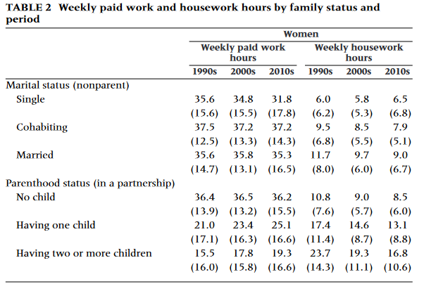
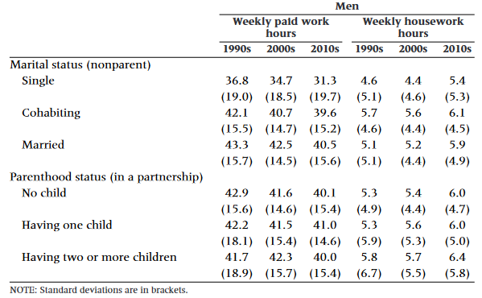
Children UK

Slide 9
Paid and unpaid work
Participation in paid work for females is up and that’s good. (Problems remain – gender pay and employment gaps).
However, the models of employment (full-time/part-time) have not changed. They are a creature of male breadwinner era.
Yes, a more equal division of unpaid work in the home would be good, but there’s no evidence it’s happening.
There is persistence and we cannot mandate how unpaid work is divided.

Slide 10
Covid
One of the most significant shifts in unpaid work was brought about by covid-19.
Biggest disruption to both paid and ultimately unpaid work.
Evidence that it did bring about greater equality in unpaid work, but effect mostly found in non-childcare work.
Where covid did bring greater equality, the end of lockdowns saw a reversion.

Slide 11
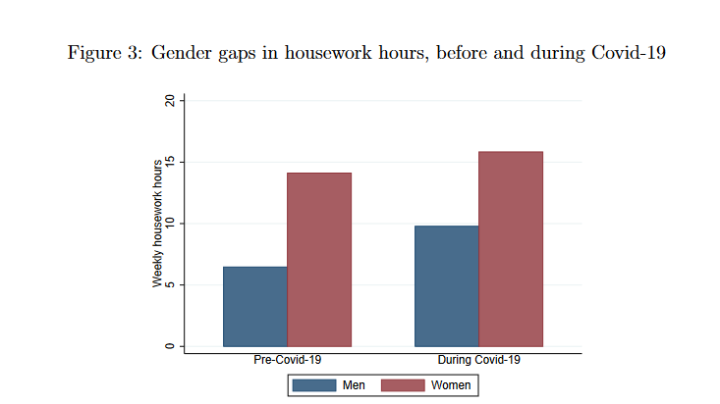
Covid

Slide 12
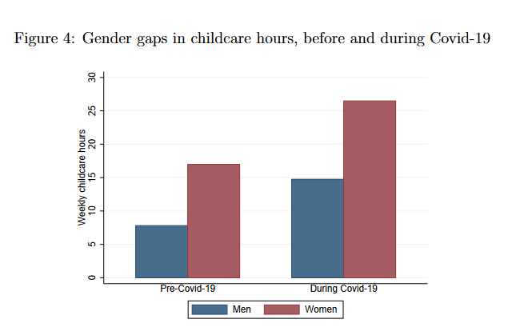
Covid

Slide 13
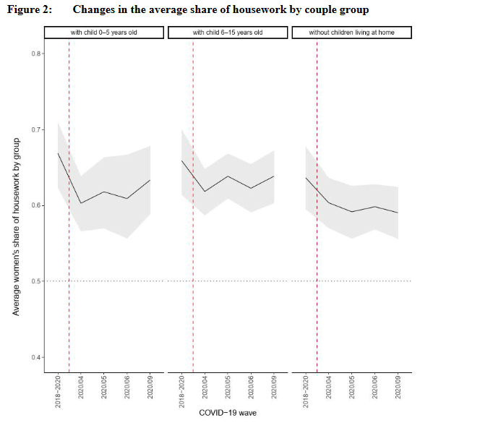
Covid

Slide 14
Valuing care
Continuing the existing (male) model of employment will not bring about a greater equality of unpaid work.
It will continue to push female workers to
  Lower quality part-time work.
  To exit the labour market.
Why can’t we have something better, something that values care and also paid work.

Slide 15
What is work?
What is care?
  WHEN ARE WE GOING TO TALK ABOUT TIME
  Need to recognise and give value to unpaid work.
  Need to focus on inferior quality of flexible and part-time work.
  Gendered differences in work are about more than pay.
Notes:
What work counts as work?
From a sociological standpoint, work encompasses not only paid employment but also unpaid labor and activities that contribute to the functioning of society. This broader definition includes household chores, caregiving, volunteer work, and other forms of productive activity. when considering both paid and unpaid work, women tend to work longer hours overall compared to men due to their disproportionate share of unpaid domestic and caregiving responsibilities.
In economics, work is typically defined as the application of effort or labor in the production of goods or services in the paid economy. It does not count and hence does not value unpaid labour.
Unpaid work encompasses all the tasks and activities that go into maintaining households and their members, such as caring for children, cooking and cleaning (we discuss a more precise definition below). While these activities are fundamental to our everyday lives and make a significant contribution to the welfare of society, they are rarely the subject of empirical investigation. The nature and distribution of unpaid work is important for a number of reasons. First, these activities and their gender distribution are important in their own right in considering gender inequality. Second, studying the gender distribution of these unpaid tasks also contributes to our understanding of gender inequality in the public sphere. Third, the value of unpaid work, particularly caring, is an important issue in relation to a range of policy debates, such as provision and funding of childcare, individualisation of taxation and the employment requirements attached to benefits for lone parents
What care counts as care?
The unequal distribution of unpaid work can impact women's ability to participate fully in the labor market and advance in their careers.
Need to focus on inferior quality of flexible and part-time work – fundamental for bargaining power of women in the home.
When are we going to talk about the depletion of mothers.
Narrow focus on increasing the offering of affordable quality childcare is not enough for mothers. It might be good for the economy, because we can squeeze people. But ignores maternal mental health, matreseance, and the notion of superheros.

Slide 16
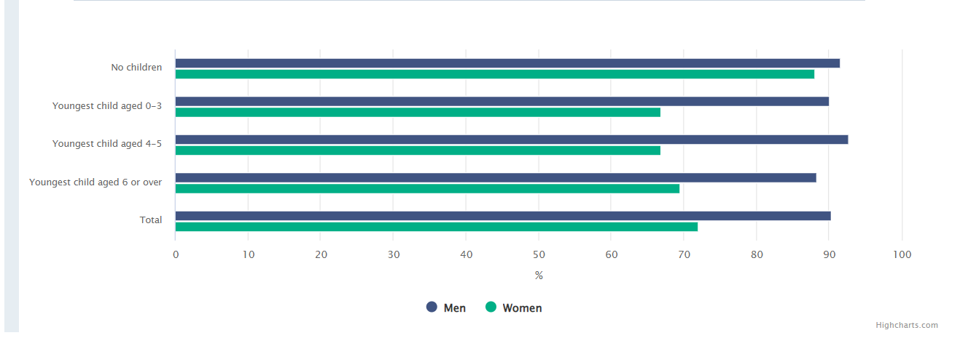
Employment rates by children, Ireland

Slide 17
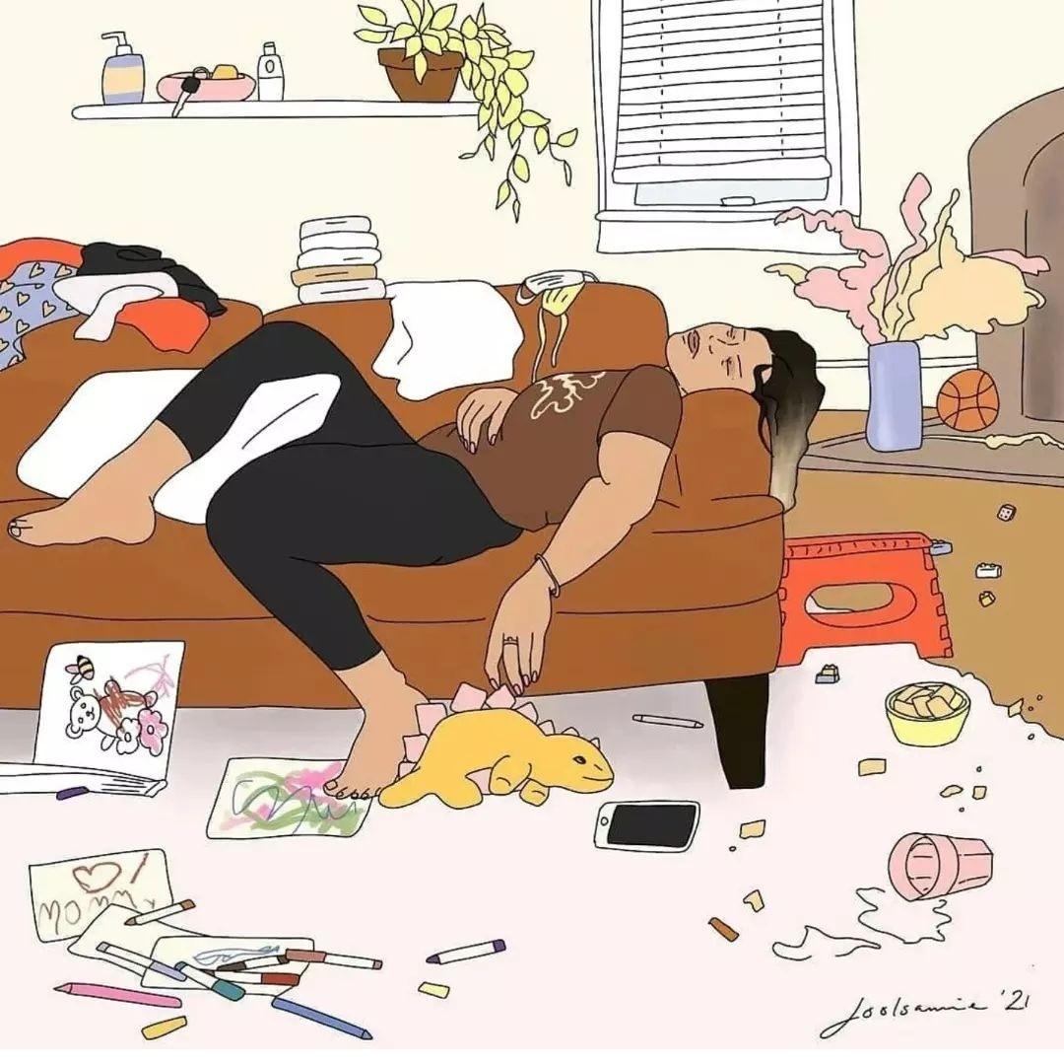
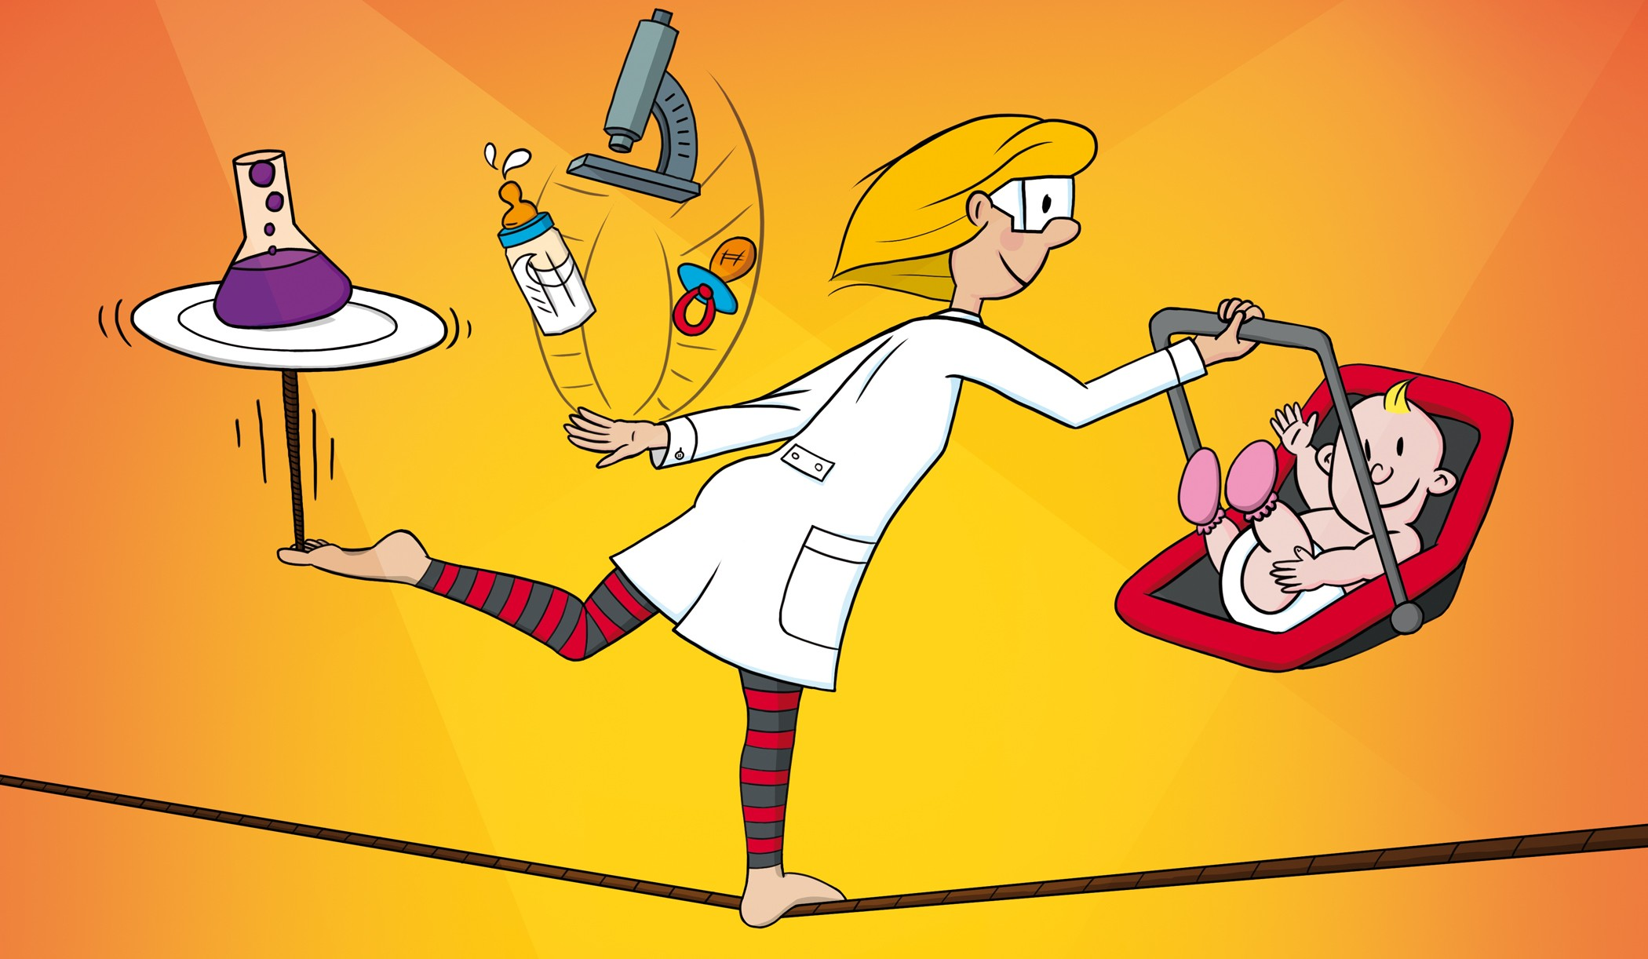
What about the third shift…..i.e. domestic labour?
And the fourth shift…. i.e. the mental load?
And the fifth shift i.e. the caregiving that can only be done by parents.
Notes:
The rise in women’s labour market participation raises the question of whether the traditional division of unpaid work has changed or if women have simply taken on a dual burden or ‘second shift’. These arguments are based on the observations that, as women increase their participation in paid labour, men do not appear to be undertaking a corresponding increase in domestic labour. The phrase ‘second shift’ was coined by Hochschild (1990), in her examination of the ‘gender strategies’ in ten households where the woman works outside the home. She shows that, in almost all of the households, the wife does far more domestic work than the husband, in so far that she does what amounts to a ‘second shift’, the first shift being her paid employment. Over one year, this second shift means that the wife does a month’s extra work per year. The difficulty with this notion, as pointed out by Bittman and Wajcman (2004), is that the concept has been used ambiguously and rarely measured empirically. Some authors have treated this idea literally and assumed that increases in paid employment are simply added to undiminished hours of unpaid work. This would lead to large differences between the total work time of men and women, more like a ‘double shift’ for women. Others argue that the typical decrease in average time spent in unpaid work is not sufficient to compensate women for increases in paid work. This second perspective would lead to women having higher total work overall, but the difference would be relatively small.

Slide 18
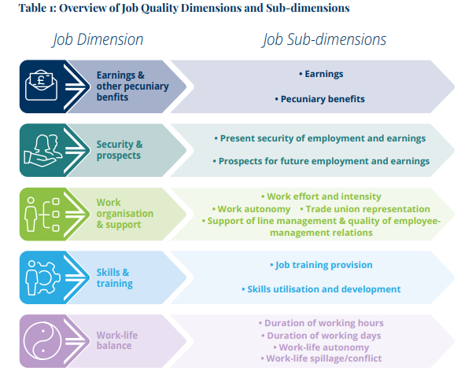
Working in Ireland Survey, 2021

Slide 19
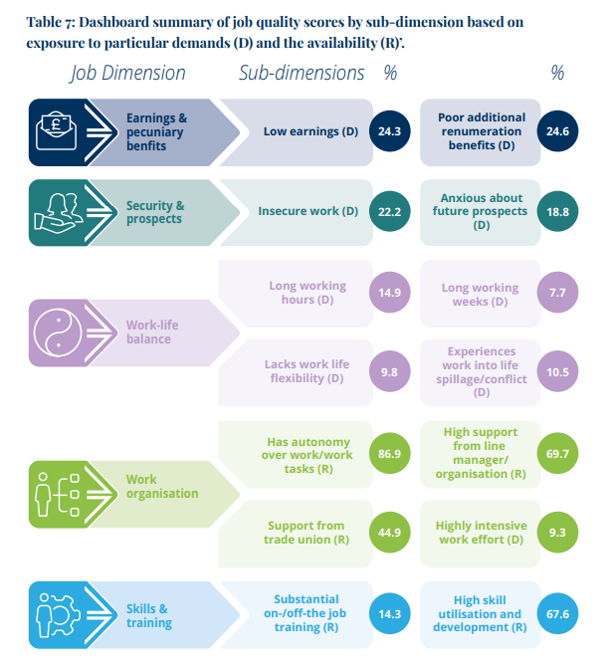
Working in Ireland Survey, 2021 (contd)

Slide 20
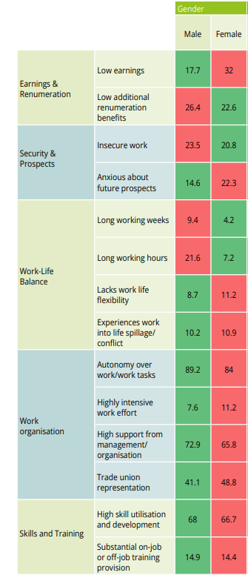
Notes:
We cannot mandate how unpaid work is divided. We can indirectly. At the minute fathers or men in households where there are caring responsibilities on average hold more bargaining power to avoid participation in unpaid labour.
Challenge to the notion that dual earner full-time model is the goal of families with caring responsibilities.

Slide 21

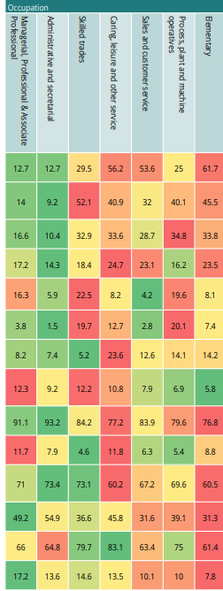
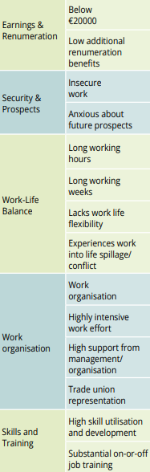

Slide 22
Valuing Care
The implications for female labour market outcomes
ICTU Women’s Conference
Athlone, 7 March 2024
WEBSITE: www.nerinstitute.net

