Slide 1

How Unequal?
The unadjusted gender pay gap in earnings in
Northern Ireland & the Republic of Ireland
NERI Webinar, 16th December 2020
Lisa Wilson
Twitter: @lisawilson_neri
WEBSITE: www.nerinstitute.net

Slide 2
Introduction
Context to the paper.
Concept.
Measurement.
Estimates.
Further NERI research.

Slide 3
Context
Policy
Northern Ireland
  Gender equality strategy & action plan.
  Gender pay transparency legislation.
Republic of Ireland.
  Missed opportunity in budget.
  Gender Pay Gap reporting bill.
  Citizens Assembly.
  Current national strategy for women & girls ends this year.

Slide 4

Notes:
There is a general air in public discussion around the gender pay gap that ‘everyone knows what the gender pay gap is’ and that the only point of contestation is whether or not it is large enough to be an issue which should be of significant policy concern. In following how this discussion plays out on social media platforms, or even on Webinars dedicated to the issue, this debate translates back across the screen as being played out amongst five rival opponents. Each are staunch that their position on the issue is one of absolute fact.
The first is one which holds that the gap in pay between males and females is so that it merits being considered as one of our most urgent social issues. The second is the opposite point of view holds that the gender pay gap is completely made up. This position was captured well recently by an online poll by TIME magazine of over 9000 Americans which found that close to half of male respondents see any estimates of the gender pay gap as representative of ‘fake news’ rather than a legitimate issue. The third is one which holds that the only information of interest when it comes to the gender pay gap is the extent to which any differences in pay are owing to gender-based discrimination, and so equate the gender pay gap with the concept of ‘unequal pay for equal work’. The fourth is a position which holds that even if the gender pay gap is real, it’s not an issue worthy of policy action, because we can explain the gap through the fact that males and females engage differently in the labour market. The fifth, is a combination of the other viewpoints, and posits that there is no real gender pay gap, but rather there is a motherhood pay gap. From this point of view any discussions around the gender pay gap are misplaced because they are not accurately diagnosing the issue.
The NERI took interest in these differing viewpoints precisely because whilst on face value it appears as though these opposing viewpoints are born out of conclusions on estimates of the gender pay gap, what is more accurate is that they are a corollary of the fact that there is little to no consensus on how we should estimate the gender pay gap. And so, it is more accurately the case that dependent upon which estimate of the gender pay gap one is presented it is not at all that unreasonable that one would arrive at one of the various different abovementioned conclusions on the matter.
Thus, when it comes to debates and discussions around the gender pay gap more often than not, the debate is being played out through different songs, albeit to the same tune.

Slide 5
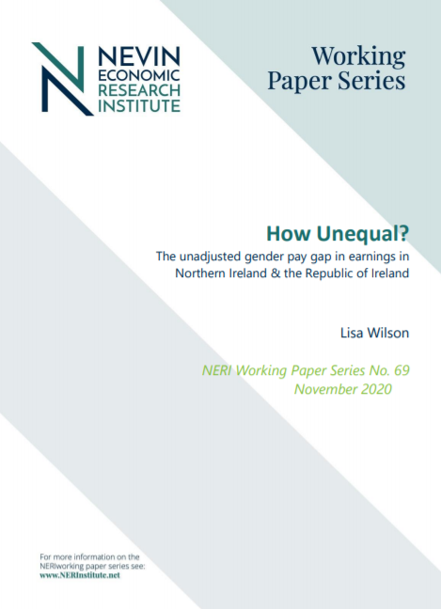
Wilson, L. (2020) How Unequal? The unadjusted gender pay gap in earnings in Northern Ireland and the Republic of Ireland, NERI Working Paper Series, NERI WP 2020/No. 69, Belfast: NERI.
Available HERE: http://nerinstitute.net/research/how-unequal-unadjusted-gender-pay-gap-earnings-northern-ireland-and-republic-ireland

Slide 6
What we measure & how we measure it matters
What is the gender pay gap?
    A metric that tells us about the difference in the earnings of males and females in the labour market.
    One of the main mechanisms used to assess the extent of gender inequalities in the labour market.
    A concept that is broader than the ‘unequal pay for equal work or work of equal value’.
    Does not capture discrimination or unequal pay for work of equal value ~ nor is this the aim.
Concept/Measurement = Estimate.

Slide 7
Conceptualisation & Measurement of the gender pay gap
Unadjusted and adjusted gender pay gaps.
Who are we comparing? i.e. are we comparing all workers? Or only full-time? Or only part-time?
What earnings period are we comparing? i.e. hourly, weekly or annual?
Which measure of the average are we comparing? i.e. mean or median?

Slide 8
Unadjusted gender pay gap
Based on a simple comparison of male and female earnings.
Particularly useful at assessing the overall extent of gender pay inequality in the labour market and the differential economic returns from work rewarded to females as compared to males.
Do not take into account all of the different factors or characteristics of males and females that may play a role in explaining the differences.
    Individuals with different characteristics are rewarded differently in the labour market.
    Structural differences in the characteristics of males and females.
    Males and females may be rewarded unequally for their labour i.e. unequal pay for equal work/work of equal value.

Slide 9
Unadjusted vs. Adjusted gender pay gap
Underlying narrative that unadjusted gender pay gap reflects ‘a gender representation gap rather than a true….GPG’.
Assumption that the only thing that matters is the ‘unequal pay’ part of gendered differences in pay i.e. discrimination gap.
Assumption that adjusted estimates of gender pay gap provide a ‘true’ or ‘accurate’ estimate of the gender pay gap.

Slide 10
International assessments of the unadjusted gender pay gap
Eurostat - mean gross hourly earnings of all males vs. all females.
  UK 19.9%
  ROI 14.4%
OECD - median gross hourly earnings of full-time males vs. full-time females.
  UK 16%
  ROI 10.6%
International Labour Organisation – recommend use of range of measures.

Slide 11
National assessments of the gender pay gap
UK & Northern Ireland
Republic of Ireland
No official report or estimate of the gender pay gap.
Positive development from NISRA who now dedicate section of ASHE report to gender pay gap.
Headline measure of gender pay gap based on gap in median hourly earnings excluding overtime of males vs. females in full-time employment only.
No official report or estimate of the gender pay gap.
Common to see Eurostat figure used as the estimate of the gender pay gap (mean hourly earnings).
CSO ‘Women & Men in Ireland’ 2019 based on comparison of median annual earnings.
CSO ‘Women & Men in Ireland’ 2013 & 2016 based on mean hourly earnings.
Notes:
Related to this is the fact that our key source of data on hourly earnings for the Republic of Ireland does not collect data breakdowns by gender. Comes from the Earnings and Labour Costs Quarterly Survey provides quarterly and annual earnings and labour costs data across economic sectors in ROI.
Administrative Data – does not provide breakdown of hours worked or hourly earnings and so it is not possible to compare the hourly earnings of males and females. As such, given what we know about the importance of working hours in determining earnings, without connecting to another data source it is not possible to sufficiently examine the gender pay gap.
The Structure of Earnings survey carried out in 2018 – does not provide data on family/household characteristics.

Slide 12
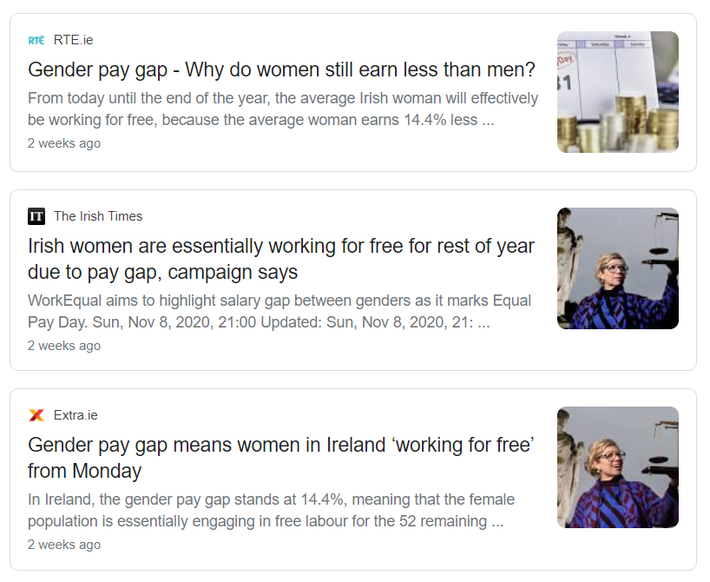
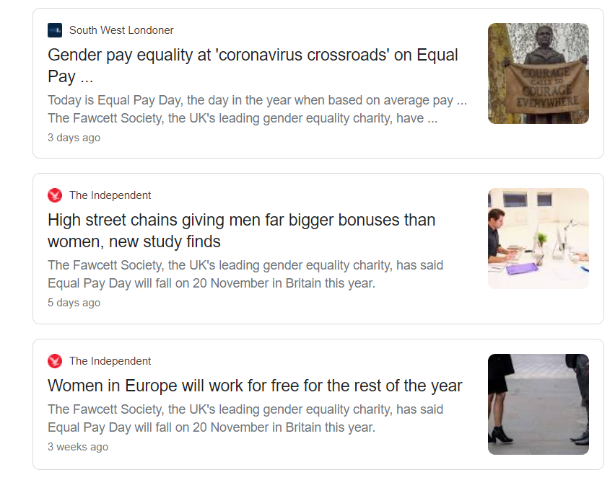
Notes:
Ireland equal pay day based on Eurostat estimate.
UK - The Fawcett Society uses the full-time mean average gender pay gap to work out when Equal Pay Day should be.

Slide 13
The gender pay gap in Northern Ireland

Slide 14
Gender Pay Gap in median and mean hourly pay:
Percentage difference in female earnings as compared to male earnings

Slide 15
 | Median Gross Weekly/Gross Annual Pay Gap | Mean Gross Weekly/Gross Annual Pay Gap
All Female vs. All Male | -29.5 | -28.42
Female Full-time vs. Male Full-time | -7.7 | -9.42
Female Part-time vs. Male Part-time | 47.2 | 15.54
Female Part-time vs. Male Full-time | -61.5 | -147.73
Female Part-time vs. All Male | -59.3 | -128.78
All Female vs. Full-time Male | -33.3 | -39.05
Percentage difference in female earnings as compared to male earnings

Slide 16
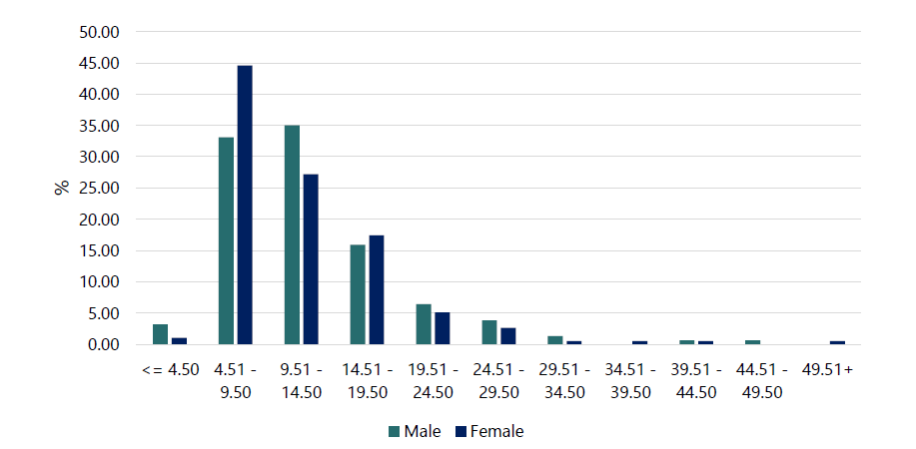
The distribution of male and female hourly earnings

Slide 17
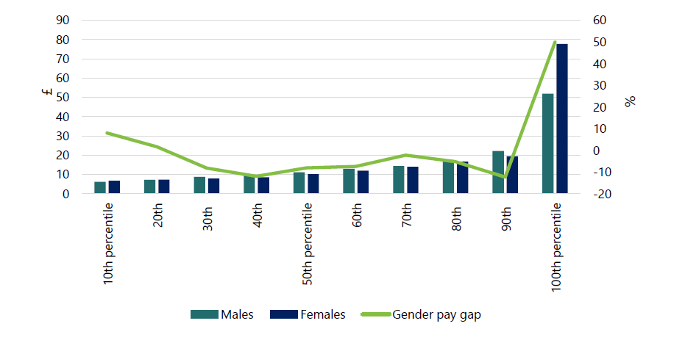
Median hourly earnings by gender across income deciles and gender pay gap in hourly earnings

Slide 18
All |  | Male | Female | Median Hourly pay | Mean hourly pay
 | % | % | % | £ | £
Age 16-29 | 18.5 | 20.2 | 17 | 7.96 | 10.30
30-39 | 23.4 | 23 | 23.8 | 10.29 | 11.49
40-49 | 25.6 | 24.6 | 26.5 | 12.15 | 13.71
50-59 | 23.4 | 23 | 23.8 | 12.09 | 13.82
60 + | 9.1 | 9.3 | 9 | 10.74 | 13.32
Educational qualifications Degree or higher | 41.2 | 36.1 | 45.9 | 14.11 | 14.87
Below Degree | 32.9 | 34.7 | 32.2 | 8.43 | 9.71
No Qualifications | 25.9 | 29.2 | 22.9 | 9.36 | 11.41
Marital Status Single | 30.7 | 29.9 | 31.4 | 8.48 | 10.71
Married/Civil Partnership | 60.5 | 65 | 56.8 | 12.38 | 13.69
Separated/ Divorced/ Widowed | 8.8 | 5.1 | 11.8 | 10.04 | 10.99
Dependent children No dependent children | 58.6 | 60.2 | 57.3 | 10.48 | 12.45
Has dependent children | 41.4 | 39.8 | 42.7 | 11.02 | 12.67
Childcare responsibilities Mainly self | 19.7 | 1.4 | 37.5 | 10.85 | 12.45
Mainly partner | 14.8 | 27.1 | 2.8 | 13.12 | 13.97
Shared | 65.5 | 71.4 | 59.7 | 11.67 | 12.98
Housework responsibilities 0 to 4 hours | 26.1 | 46.1 | 11.7 | 10.86 | 12.89
5 to 9 hours | 19 | 24.8 | 14.8 | 11.11 | 12.33
10 + hours | 54.9 | 29.1 | 73.5 | 10.22 | 12.35
Working hours 0 to 15 hours | 5.8 | 1.9 | 9.1 | 8.01 | 14.06
16 to 30 hours | 28.1 | 15.4 | 38.4 | 8.65 | 10.64
31+ hours | 66.1 | 82.7 | 52.5 | 11.82 | 13.24
Employment arrangements
Permanent | 93.8 | 93.5 | 94.1 | 10.87 | 12.71
Temporary | 6.2 | 6.5 | 5.9 | 8.11 | 10.03
Average differences in hourly earnings by personal/family characteristics, across gender

Slide 19
 | Median hourly earnings |  | Percentage difference in female earnings as compared to male earnings (median) | Mean hourly earnings |  | Percentage difference in female earnings as compared to male earnings (mean)
Age | Male | Female | All | Male | Female | All
16-29 | 7.95 | 8.11 | 2.0 | 9.81 | 10.77 | 9.8
30-39 | 10.01 | 10.31 | 3.0 | 10.78 | 12.03 | 11.6
40-49 | 12.85 | 11.67 | -9.2 | 14.53 | 13.04 | -10.3
50-59 | 13.08 | 11.40 | -12.8 | 15.05 | 12.91 | -14.2
60 + | 12.95 | 9.21 | -28.9 | 15.06 | 11.96 | -20.6
Educational qualifications Degree or higher | 13.83 | 14.12 | 2.1 | 14.83 | 14.89 | 0.4
Below Degree | 9.72 | 8.36 | -14.0 | 9.76 | 9.65 | -1.1
No Qualifications | 10.82 | 8.25 | -23.8 | 12.27 | 10.40 | -15.2
Marital Status Single | 8.41 | 8.56 | 1.8 | 10.19 | 11.11 | 9.0
Married/Civil Partnership | 12.75 | 11.99 | -6.0 | 14.14 | 13.27 | -6.2
Separated/ Divorced/ Widowed | 12.63 | 9.95 | -21.2 | 11.31 | 10.89 | -3.7
Dependent children No dependent children | 10.71 | 10.10 | -5.7 | 12.88 | 12.09 | -6.1
Has dependent children | 11.53 | 10.29 | -10.8 | 12.77 | 12.59 | -1.4
Childcare responsibilities |  |  | -
Mainly self | - | 10.97 | - | - | 12.49 | -
Mainly partner | 14.12 | - | - | 14.63 | - | -
Shared | 11.37 | 12.87 | 13.2 | 12.18 | 13.96 | 14.6
Housework responsibilities 0 to 4 | 10.89 | 10.45 | -4.0 | 12.88 | 12.91 | 0.2
5 to 9 | 11.31 | 10.77 | -4.8 | 12.61 | 11.99 | -4.9
10 + hours | 11.51 | 10.12 | -12.1 | 12.94 | 12.17 | -6.0
Working hours 0 to 15 hours | 8.09 | 8.42 | 4.1 | 15.88 | 13.76 | -13.4
16 to 30 hours | 8.11 | 8.79 | 8.4 | 9.45 | 11.03 | 16.7
31+ hours | 12.14 | 11.75 | -3.2 | 13.42 | 12.99 | -3.2
Employment arrangement Permanent | 11.41 | 10.28 | -9.9 | 13.26 | 12.27 | -7.5
Temporary | 5.49 | 8.84 | 61.0 | 6.72 | 13.31 | 98.1
Gender pay gap in hourly earnings based on worker & household/family structure characteristics

Slide 20
 | All | Male | Female | Median Hourly pay | Mean Hourly pay
 | % | % | % | £ | £
Occupation Managerial, Directors & SO | 8.6 | 10.6 | 6.5 | 15.23 | 17.94
Professional | 15.2 | 15.0 | 15.1 | 17.54 | 18.47
Associate Professional & Technical | 16.9 | 11.9 | 21.6 | 14.26 | 14.75
Administrative & Secretarial | 12.5 | 8.8 | 15.7 | 10.70 | 11.77
Skilled trades | 7.9 | 16.3 | 1.1 | 10.88 | 12.34
Caring, Leisure & Other service | 7.9 | 2.5 | 12.4 | 8.02 | 9.59
Sales & Customer service | 9.8 | 6.9 | 11.9 | 7.33 | 8.25
Process, Plant & Machine | 6.6 | 10.6 | 3.2 | 10.33 | 11.09
Elementary | 14.6 | 17.5 | 12.4 | 7.60 | 8.41
Industry Agriculture, Forestry, Fishing, Electricity, Water | 1.4 | 1.8 | 1.0 | 15.96 | 14.60
Manufacturing | 10.1 | 17.2 | 4.4 | 12.32 | 13.27
Construction | 3.1 | 6.5 | - | 9.78 | 11.64
Wholesale, Retail & Transportation | 15.6 | 15.4 | 15.7 | 8.34 | 9.19
Accommodation & Food | 5.5 | 5.9 | 5.4 | 7.29 | 6.99
Information, Comms, Financial, Insurance & Real Estate | 6.3 | 8.3 | 4.4 | 12.96 | 15.02
Professional, Technical, Scientific, Administration | 6.9 | 8.3 | 5.9 | 10.49 | 13.37
Public admin, Health, Education | 44.2 | 26.0 | 58.8 | 12.63 | 14.13
Arts, Entertainment & Recreation | 3.3 | 5.3 | 2.0 | 8.77 | 9.52
Other service activities | 3.6 | 5.3 | 2.5 | 9.77 | 10.22
Sector of employment Public | 42.9 | 31.6 | 52.1 | 9.15 | 10.95
Private | 57.1 | 68.4 | 47.9 | 13.25 | 14.67
Number employed at workplace 0-24 | 36.5 | 33.7 | 38.7 | 8.70 | 10.58
25-99 | 26.2 | 24.5 | 27.6 | 10.78 | 12.96
100 + | 37.3 | 41.7 | 33.7 | 12.95 | 14.19
Gender differences in the structure of employment

Slide 21
Gender Pay Gap in hourly earnings: Percentage difference in female earnings as compared to male earnings
 | Median hourly earnings |  | GPG (median) | Mean hourly earnings |  | GPG (mean)
 | Male | Female | All | Male | Female | All
Occupation Managerial, Directors, Senior Officials | 15.54 | 15.23 | -2.0 | 18.15 | 17.64 | -2.8
Professional | 15.78 | 18.92 | 19.9 | 16.73 | 19.90 | 18.9
Associate Professional & Technical | 14.57 | 14.25 | -2.2 | 15.10 | 14.58 | -3.4
Administrative & Secretarial | 10.31 | 10.72 | 4.0 | 12.50 | 11.39 | -8.9
Skilled trades | 11.41 | 7.56 | -33.7 | 12.61 | 7.05 | -44.1
Caring, Leisure & Other service | 9.72 | 7.80 | -19.8 | 15.69 | 8.71 | -44.5
Sales & Customer service | 7.28 | 7.50 | 3.0 | 8.57 | 8.10 | -5.5
Process, Plant & Machine | 10.78 | 7.39 | -31.4 | 11.56 | 9.78 | -15.4
Elementary | 7.82 | 7.58 | -3.1 | 8.26 | 8.59 | 4.0
Industry Agriculture, Forestry, Fishing, Electricity, Water | 17.94 | 13.90 | -22.5 | 16.91 | 10.76 | -36.4
Manufacturing | 12.76 | 10.69 | -16.2 | 13.58 | 12.24 | -9.9
Construction | 9.10 | 12.64 | 38.9 | 11.61 | 12.64 | 8.9
Wholesale, Retail & Transportation | 9.58 | 7.98 | -16.7 | 10.14 | 8.47 | -16.5
Accommodation & Food | 5.12 | 7.58 | 48.0 | 5.71 | 8.12 | 42.2
Information, Comms, Financial, Insurance & Real Estate | 12.96 | 12.96 | 0.0 | 15.09 | 14.91 | -1.2
Professional, Technical, Scientific, Administration | 10.65 | 10.38 | -2.5 | 12.44 | 14.57 | 17.1
Public admin, Health, Education | 14.31 | 11.96 | -16.4 | 15.78 | 13.53 | -14.3
Arts, Entertainment & Recreation | 9.38 | 7.66 | -18.3 | 9.30 | 9.95 | 7.0
Other service activities | 9.77 | 7.08 | -27.5 | 10.99 | 8.42 | -23.4
Sector of Employment Private | 9.92 | 8.22 | -17.1 | 11.54 | 10.28 | -10.9
Public | 13.94 | 12.66 | -9.2 | 15.66 | 14.18 | -9.5
Number employed at workplace 0-24 | 9.32 | 8.53 | -8.5 | 10.77 | 10.45 | -3.0
25-99 | 10.85 | 10.89 | 0.4 | 12.28 | 13.43 | 9.4
100 + | 13.38 | 12.01 | -10.2 | 14.85 | 13.52 | -9.0

Slide 22
The gender pay gap in the Republic of Ireland

Slide 23
Gender Pay Gap in median and mean hourly pay:
Percentage difference in female earnings as compared to male earnings

Slide 24
 | Median Gross Weekly/Gross Annual Pay Gap | Mean Gross Weekly/Gross Annual Pay Gap
All Female vs. All Male | -20.49 | -22.93
Female Full-time vs. Male Full-time | -4.18 | -11.56
Female Part-time vs. Male Part-time | 10.31 | 11.11
Female Part-time vs. Male Full-time | -65.60 | -65.48
Female Part-time vs. All Male | -62.19 | -61.90
All Female vs. Full-time Male | -27.65 | -43.22
Percentage difference in female earnings as compared to male earnings

Slide 25
The distribution of male and female hourly earnings

Slide 26
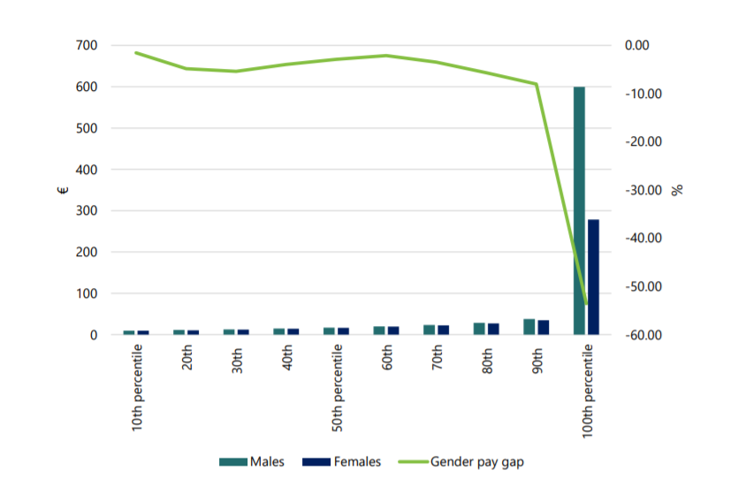
Median hourly earnings by gender across income deciles and gender pay gap in hourly earnings

Slide 27
 | All | Male | Female | Median Hourly pay | Mean hourly pay
 | % | % | % | € | €
Age 15-24 | 10.1 | 11.5 | 8.7 | 10.50 | 11.78
25-49 | 62.5 | 60.8 | 64.1 | 17.21 | 21.51
50-64 | 26 | 26.5 | 25.6 | 19.92 | 24.48
65+ | 1.4 | 1.2 | 1.6 | 14.00 | 19.98
Educational qualifications Degree or higher | 36.3 | 32.5 | 40.2 | 23.64 | 27.17
Below Degree | 60.1 | 63.6 | 56.6 | 14.11 | 17.83
No Qualifications | 3.6 | 3.9 | 3.2 | 12.41 | 14.63
Marital Status Single | 36.1 | 36.2 | 36 | 13.12 | 16.8
Married/Civil Partnership | 58.5 | 60.5 | 56.6 | 19.43 | 24.06
Separated/ Divorced/ Widowed | 5.4 | 3.3 | 7.4 | 16.92 | 21.1
Household type Adults & No children in household | 47.2 | 47.2 | 47.1 | 16.14 | 21.01
1 adult and 1+ children u18 | 3.2 | 0.7 | 5.6 | 14.11 | 17.89
2 adults and 1-3 children u18 | 34.8 | 36.3 | 33.1 | 18.66 | 22.63
Other households’ w/ children u18 | 14.9 | 15.8 | 14 | 14.64 | 19.63
Working hours 0 to 15 hours | 7.6 | 4.3 | 11 | 12.13 | 29.2
16 to 30 hours | 22.2 | 11.9 | 32.4 | 13.76 | 18.76
31+ hours | 70.2 | 83.8 | 56.6 | 17.85 | 21.2
Working arrangement Full-time | 75.8 | 86.3 | 65.4 | 18.25 | 22.89
Part-time | 24.2 | 13.7 | 34.6 | 12.25 | 16.15
Average differences in hourly earnings by personal/family characteristics, across gender

Slide 28
 | Median hourly earnings |  | Percentage difference in female earnings as compared to male earnings (median) | Mean hourly earnings |  | Percentage difference in female earnings as compared to male earnings (mean)
 | Male | Female |  | Male | Female
Age 15-24 | 10.58 | 10.4 | -1.70 | 11.25 | 12.47 | 10.84
25-49 | 17.79 | 16.51 | -7.20 | 22.67 | 20.42 | -9.93
50-64 | 20.12 | 19.61 | -2.53 | 26.28 | 22.61 | -13.97
65+ | 12.03 | 15.58 | 29.51 | 20 | 19.98 | -0.10
Educational Qualifications
Degree or higher | 25 | 22 | -12.00 | 28.66 | 25.96 | -9.42
Below Degree | 14.64 | 13.46 | -8.06 | 19.12 | 16.39 | -14.28
No Qualifications | 14.11 | 11.18 | -20.77 | 16.05 | 12.84 | -20.00
Marital Status Single | 13.16 | 13.13 | -0.23 | 16.2 | 17.4 | 7.41
Married/Civil Partnership | 19.72 | 18.66 | -5.38 | 25.85 | 22.14 | -14.35
Separated/ Divorced/ Widowed | 17.44 | 16.33 | -6.36 | 23.59 | 19.99 | -15.26
Dependent children
Adults & No children in household | 15.89 | 16.78 | 5.60 | 21.37 | 20.66 | -3.32
1 adult and 1+ children u18 | 12.83 | 14.12 | 10.05 | 14.27 | 18.29 | 28.17
2 adults and 1-3 children u18 | 19.46 | 17.42 | -10.48 | 24.03 | 21.11 | -12.15
Other households with children u18 | 14.88 | 14.12 | -5.11 | 21.29 | 17.77 | -16.53
Working hours 0 to 15 hours | 12.33 | 12.13 | -1.62 | 47.69 | 21.98 | -53.91
16 to 30 hours | 12.03 | 15.16 | 26.02 | 17.17 | 19.34 | 12.64
31+ hours | 17.79 | 17.88 | 0.51 | 21.69 | 20.46 | -5.67
Gender pay gap in hourly earnings based on worker & household/family structure characteristics

Slide 29
Gender differences in the structure of employment
 | All | Male | Female | Median Hourly pay | Mean Hourly pay
 | % | % | % | € | €
Occupation Managerial, Directors, Senior Officials | 5.5 | 7.5 | 3.6 | 27.06 | 29.16
Professional | 21.1 | 17.1 | 25.1 | 27.41 | 30.45
Associate Professional & Technical | 12.4 | 14.1 | 10.7 | 21.49 | 24.76
Administrative & Secretarial | 12 | 5 | 19.1 | 17.5 | 19.69
Skilled trades | 9.8 | 17.4 | 2.2 | 15.62 | 17.4
Caring, Leisure & Other service | 9.8 | 3.6 | 14.1 | 12.83 | 15.3
Sales & Customer service | 9.3 | 7.3 | 11.3 | 11.51 | 13.14
Process, Plant & Machine | 7.3 | 12.3 | 2.3 | 13.94 | 15.71
Elementary | 13.7 | 15.7 | 11.6 | 11.43 | 17.31
Industry Agriculture, Forestry, Fishing, Electricity, Water | 2.4 | 3.7 | 1.1 | 13.70 | 20.26
Manufacturing | 11.7 | 16 | 7.4 | 17.42 | 20.16
Construction | 4.4 | 8.1 | 0.7 | 16.75 | 17.41
Wholesale, Retail & Transportation | 19.9 | 23.5 | 16.3 | 13.53 | 16.88
Accommodation & Food | 7.1 | 5.5 | 8.7 | 11 | 13.38
Information, Comms, Financial, Insurance & Real Estate | 9.8 | 11.2 | 8.4 | 23.64 | 27.58
Professional, Technical, Scientific | 8.8 | 10.4 | 7.3 | 15.55 | 20.04
Public admin, Health, Education | 31.7 | 18.5 | 44.9 | 21.64 | 25.91
Arts, Entertainment & Recreation | 1.9 | 1.6 | 2.1 | 14.41 | 17.86
Other service activities | 2.3 | 1.5 | 3.1 | 11.27 | 15.54
Number employed at workplace 0-19 | 9.9 | 8.7 | 11 | 13.3 | 17.76
20-49 | 38.2 | 36.1 | 40.3 | 14.30 | 19.35
50 + | 48.2 | 51.3 | 45.1 | 20.00 | 24.08
Do not know but more than 10 | 3.7 | 4 | 3.5 | 16.66 | 19.32

Slide 30
Gender Pay Gap in hourly earnings: Percentage difference in female earnings as compared to male earnings
 | Median hourly earnings |  | Percentage difference in female earnings compared to male earnings | Mean hourly earnings |  | Percentage difference in female earnings compared to male earnings
 | Male | Female |  | Male | Female
Occupation Managerial, Directors, Senior Officials | 26.83 | 31.05 | 15.73 | 29.83 | 27.74 | -7.01
Professional | 28.44 | 27.10 | -4.71 | 31.69 | 29.61 | -6.56
Associate Professional & Technical | 21.11 | 21.49 | 1.80 | 25.56 | 23.69 | -7.32
Administrative & Secretarial | 20.14 | 17.32 | -14.00 | 21.51 | 19.21 | -10.69
Skilled trades | 15.93 | 11.20 | -29.69 | 17.78 | 14.31 | -19.52
Caring, Leisure & Other service | 14.95 | 12.51 | -16.32 | 16.42 | 15.01 | -8.59
Sales & Customer service | 12.50 | 11.08 | -11.36 | 13.85 | 12.67 | -8.52
Process, Plant & Machine | 14.00 | 13.34 | -4.71 | 15.99 | 14.20 | -11.19
Elementary | 11.82 | 10.77 | -8.88 | 20.90 | 12.53 | -40.05
Industry Agriculture, Forestry, Fishing, Electricity, Water | 14.12 | 12.62 | -10.62 | 21.74 | 15.16 | -30.27
Manufacturing | 18.32 | 16.41 | -10.43 | 20.88 | 18.61 | -10.87
Construction | 16.87 | 16.75 | -0.71 | 17.38 | 17.69 | 1.78
Wholesale, Retail & Transportation | 14.58 | 11.73 | -19.55 | 19.08 | 13.74 | -27.99
Accommodation & Food | 10.97 | 11.12 | 1.37 | 12.86 | 13.71 | 6.61
Information, Comms, Financial, Insurance & Real Estate | 25.38 | 21.69 | -14.54 | 28.33 | 26.57 | -6.21
Professional, Technical, Scientific | 16.44 | 14.58 | -11.31 | 21.55 | 17.88 | -17.03
Public admin, Health, Education | 21.47 | 21.66 | 0.88 | 29.96 | 24.24 | -19.09
Arts, Entertainment & Recreation | 14.42 | 14.19 | -1.60 | 16.58 | 17.86 | 7.72
Other service activities | 14.64 | 10.21 | -30.26 | 17.61 | 14.55 | -17.38
Number employed at workplace 0-19 | 13.16 | 14.21 | 7.98 | 16.65 | 18.63 | 11.89
20-49 | 14.74 | 14 | -5.02 | 20.81 | 18.06 | -13.21
50 + | 20.7 | 19.44 | -6.09 | 24.84 | 23.23 | -6.48
Do not know but more than 10 | 17.65 | 15.24 | -13.65 | 20.51 | 17.93 | -12.58

Slide 31
Unadjusted gender pay gap NI vs. ROI
Overarching story is that females earn less than males.
But males in part-time employment in both NI & ROI earn less than females.
Gendered differences in pay manifest differently in NI vs. ROI.
Education. In NI Reward to females for having a degree or above level of education are high….but as is Penalty for no qualifications. Not so in ROI.
Sector. Public sector employment plays key role in reducing gender pay gap estimate based on the mean.

Slide 32
NERI research on gender pay gap
This paper is first of two papers focused on gender pay gap.
Second paper to be published early 2021.
Second paper will focus on:
  The adjusted gender pay gap in Northern Ireland & Republic of Ireland. i.e. causes/explanatory factors of the gender pay gap.
  Policy suggestions to narrow/reduce the gender pay gap.

Slide 33
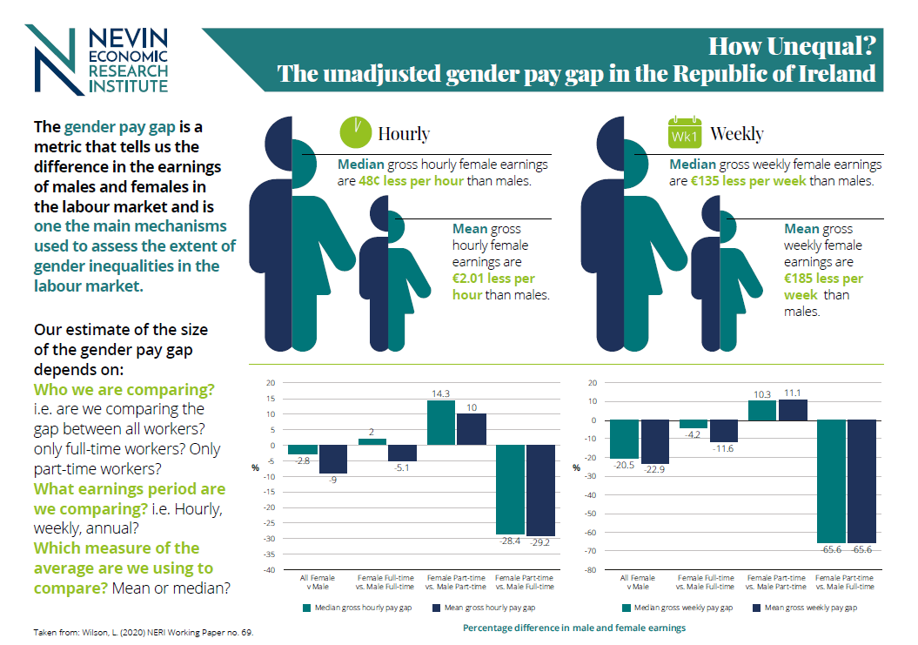
Check out the ‘Visualising our economy’ tab on our website for summaries of our key findings http://nerinstitute.net/visualising-our-economy

Slide 34
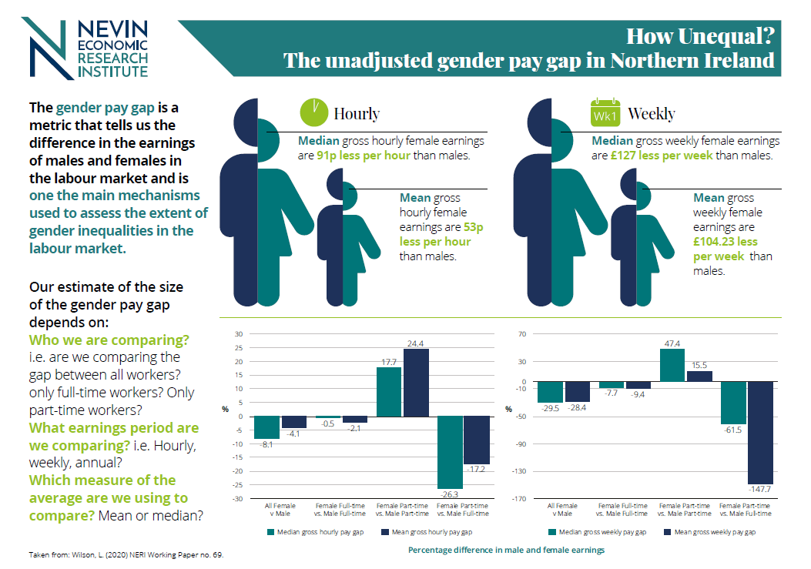
Check out the ‘Visualising our economy’ tab on our website for summaries of our key findings http://nerinstitute.net/visualising-our-economy

Slide 35
How Unequal?
The unadjusted gender pay gap in earnings in
Northern Ireland &the Republic of Ireland
Lisa Wilson
Twitter: @lisawilson_neri
WEBSITE: www.nerinstitute.net

