Slide 1

Capitalism and Neoliberalism
A primer and a discussion
10th June 2020
Maynooth University
Dr Tom McDonnell Twitter: @TomAMcDonnell1
WEBSITE: www.nerinstitute.net

Slide 2
Economics and varieties of Capitalism

Slide 3
What do economists study?
Economic problems
  production and consumption
Scarcity: the central economic problem
  defining scarcity
    distribution
  use of resources (factors of production)
    labour
    land and raw materials
    capital
    ideas
  demand and supply
Notes:
2

Slide 4
The circular flow of goods and incomes
Goods and services
€
Consumer
expenditure
GOODS MARKETS
FACTOR MARKETS
Wages, rent
dividends, etc.
€
Services of factors of production (labour, capital, etc)

Slide 5
The institutional sectors
Households (including the non-profit sector)
Firms (financial and non-financial companies)
Government
We measure the size of the economy by adding up the value of the goods and services produced in a given year
  Total production (output) of goods and services is called GDP (Gross Domestic Product)

Slide 6
Demand and Supply
potential demand will almost invariably outstrip potential supply
markets equate actual demand with actual supply by raising or lowering prices
  prices usually (but not always) in monetary terms
competitive markets:
  Individual consumers and producers are too numerous to have a significant impact on prices i.e. they are more or less price takers
  Competitive markets are rare in the real world but give us a basic framework

Slide 7
Equilibrium
Equilibrium in the economy where D and S curves intersect
  if D > S, price level will rise
  if D < S, price level will fall
P
S
P*
D
0
Y*
Y

Slide 8
Features of the four market structures

Slide 9
All modern economies are welfare state
A form of economic and social organisation
  A system in which the state plays a role in the protection of its citizens
  Not just physical protection and the maintenance of order, but promotion of the economic and social well-being of its citizens
The welfare state can be seen as a combination of collectivism, capitalism, social welfare policy and democracy

Slide 10
Policy debates
economic and political right argue for a laissez-faire approach to the economy on the part of government - governments job is to ensure free and competitive markets
  The right argue that free markets are the most efficient (least wasteful) way to achieve economic prosperity
centre/left argue that disequilibria can persist for long periods of time (markets don't work!) and that therefore (e.g.) government intervention to boost aggregate demand is necessary to bring the economy towards full employment
  The centre and the left also argue that government intervention is needed in order to achieve certain social goals such as:
    Full employment
    poverty reduction,
    reduced inequality,
    environmental protection etc.

Slide 11
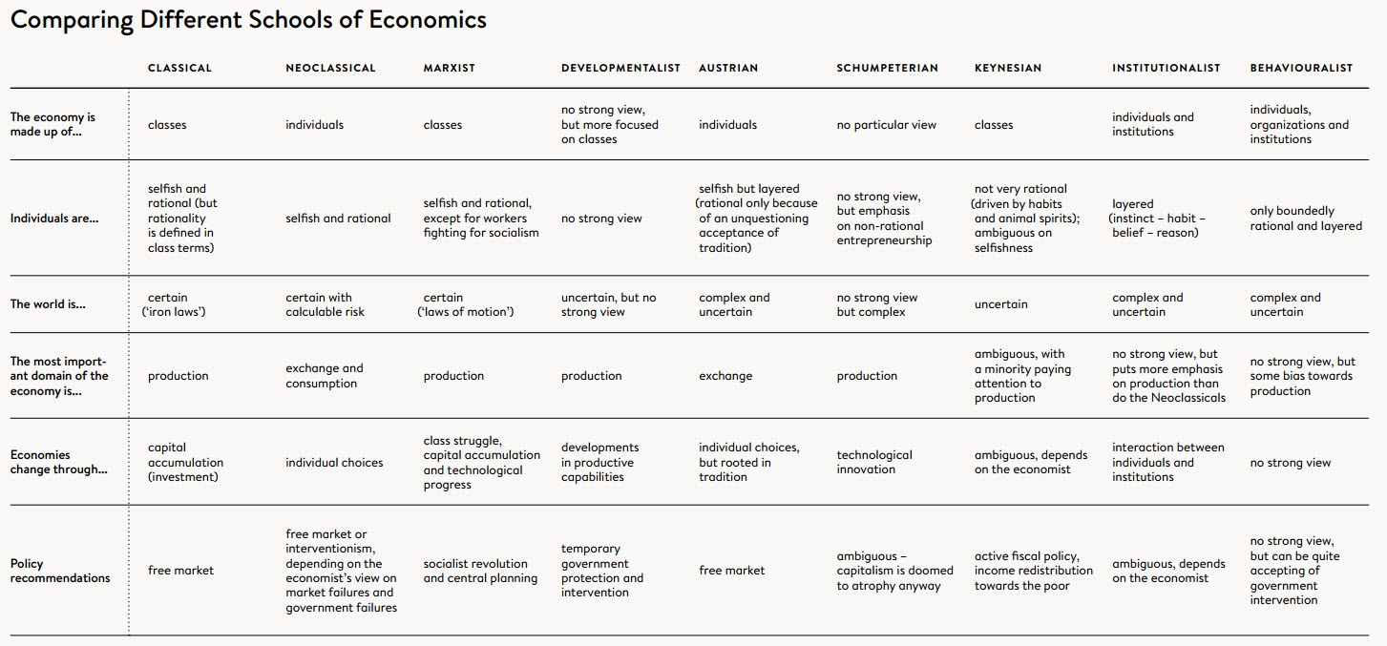

Slide 12
Varieties of capitalism
Different societies have developed different ways of organising their economies, even within the apparently universal ideology of capitalism.
In the contemporary world economy there are three distinctive types of political economic system.
Neo-liberal market capitalism – US, UK, Ireland?
Social-market capitalism – Germany, most of Europe
Developmental capitalism – Japan, most East Asia

Slide 13
Varieties of Capitalism (Cont.)
The essence of these governance models is their differing conception of the ‘proper’ role of government in regulating the economy.
Neo-liberal: market mechanisms are used to regulate all or most aspects of the economy.
Individualism is dominant – short term business goals predominate – the state does not overtly attempt to plan the economy strategically.
Dominant philosophy is ‘shareholder value’ – facilitating maximum returns to the owners of capital

Slide 14
Varieties of capitalism (Cont.)
Social-market: places a higher premium upon collaboration between different actors in the economy.
Has a broader definition of ‘stakeholders’ beyond that of owners of capital
Developmental: the state plays a much more central role – features the setting of substantial social and economic goals
– greatest precedence to industrial policy i.e. to promoting the structure of domestic industry that enhances the nation’s international competitiveness
– a goal-oriented approach.

Slide 15
Neoliberalism

Slide 16
Intellectual Origins
Neoliberalism must be distinguished from liberalism.
Neoliberalism is only concerned with ‘economic’ freedom – it is agnostic on issues of social justice, democracy and equality
  The individual is solely responsible for the consequences of their own choices
  State intervention eventually will lead to totalitarianism
  Individuals are perfectly rational and have better information than the state as to their own needs
Appropriate role for the state is seen as that of a night watchman – courts, police and military are justified expenditure to the extent that they enforce individual and commercial liberty
The institutional framework or ‘rules of the game’ should support private property rights and the proper functioning of markets - state intervention should be restricted to the bare minimum – a laissez faire approachg
Friedrich Hayek:
  ‘Freedom to choose’
Milton Friedman:
  ‘free markets (and free trade) are the optimal way to organise an exchange of goods and services’ – ‘states don’t have enough information’

Slide 17
Neoliberal agenda
Supremacy of the individual and commercial interests over that of society
  Thatcher ‘ no such thing as society’
Neoliberal agenda:
  Free trade
  Privatisation
  Shrinking of the state
  Large tax cuts
  Balanced budgets or ‘austerity’ (because state intervention always fails)
Neoliberalism is consistent with autocratic regimes and with democratic regimes
  Its about ‘economic’ freedom not ‘egalitarian’ or ‘participative’ freedom
Neoliberalism has never been the dominant school amongst academic economists – it is fundamentally a political and ideological project

Slide 18
Political revolution
Keynesian ‘stagflation’ of the 1970s and the end of the golden era of capitalism (1945-1973)
Rise of the monetarists in the 1980s and 1990s – Pinochet, Thatcher, Reagan, Clinton
  Scepticism of democracy where it threatens individual or commercial liberty
IMF and World Bank enforce neoliberal policies on developing economies from the 1970s onwards (mainly in Latin America and Africa)
  The Washington Consensus involved fiscal consolidation, privatisation, openness to capital flows, reduction of trade barriers, deregulation
    Technocratic rule
  However, East Asian countries continue to pursue more developmentalist models and outperform other developing economies

Slide 19
Costs of neoliberalism
International capital flows generate economic instability
  Latin America (1980s), East Asia (1990s), Global financial crash (2008) etc etc
Deregulation, attacks on trade unions, tax cuts, privatisation and smaller states are all linked to rising inequality
  Incomes have grown fastest at the top since the early 1980s in those countries that have embraced the neoliberal policy suite
  Relative income stagnation at the bottom half of the distribution
    Rising inequality has generated a backlash against globalisation and a rise in nationalism (alienation of the rust belts)
  Inequality undermines democracy itself as ‘winners’ rig the system in their favour via their disproportionate influence on and lobbying of policymakers
The neoliberal model (i.e. minimal regulation, profit seeking to the exclusion of all else) has intensified climate chaos
    Neoliberals often deny the existence of climate change because it would imply a need for regulation – and an attack on individual freedom

Slide 20
Post-2008: A contested space
The neoliberal agenda was dominant from 1979 to 2008
  The financial crash fundamentally discredited the policies of deregulation and unfettered capital flows
  Austerity is blamed for the prolongation of the Euro crisis, while austerity and globalisation are both credited with fuelling inequality and the rise of far right parties around the world
The IMF and OECD have gradually moved away from neoliberal policies over the last decade
At any rate, neoliberal policies have always been highly contested in Europe and in Asia. Many European countries spend in excess of 40% of their GDP on public spending
The covid-19 crisis has shown that private markets are fundamentally dependent on the State

